Slide 1
SLS & Sustainable Communities

Slide 2
How Does SLS Approach Sustainable Communities?
SOCIETY
1. As an Integrated System – with an emphasis on projects and initiatives that address two or more spheres
Societal/ Economic
Societal/
Environmental
ECONOMY
ENVIRONMENT
Economic/
Environmental

Slide 3
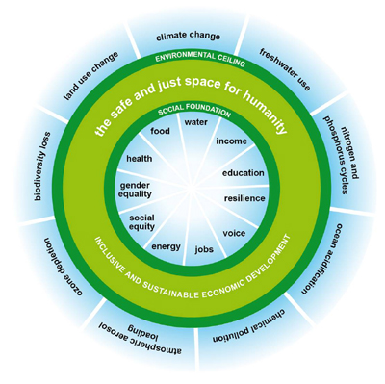
How Does SLS Approach Sustainable Communities?
2. With a special focus on Society, including Equity and Voice
“The overriding aim of global economic development must surely be to enable humanity to thrive in the safe and just space, ending human deprivation while keeping within safe boundaries of natural resource use locally, regionally, and globally.” - Kate Raworth, Oxfam Doughnut
Website: http://www.kateraworth.com/doughnut/ Video: https://www.oxfam.org/en/video/2012/introducing-doughnut-safe-and-just-space-humanity

Slide 4
Voice and Community Engagement
Focusing on VOICE means supporting shared leadership and community-driven change
Increasing level of community involvement, impact, trust and communication
From Schematic of Community Engagement Continuum (EPA, 2015; NCER CEnR Primer; note that this is one piece of a larger diagram)
Read more about our Partnership Principles in our BIG IDEAS: http://serve-learn-sustain.gatech.edu/big-ideas

Slide 5
How Does SLS Approach Sustainable Communities?
3. And an approach to Technology that centers social innovation, community voice, and sustainability
SOCIETY
NATURE
TECHNOLOGY

Slide 6
How Can Technology Assist Communities in Supporting Society and Nature?
Address basic needs and advance equity
Nurture civic participation and amplify community voices
Strengthen social ties and other connections to place
Bolster human capital
Preserve cultural diversity
Nurture vibrant, diverse economies
Support local innovation, entrepreneurship, and ownership
Protect natural resources
Preserve and restore biological diversity
Reduce energy use
Manage and recycle waste
SOCIETY
NATURE
TECHNOLOGY
*Adapted in part from Jeffrey C. Bridger and A.E. Luloff, “Toward an interactional approach to sustainable community development,” Journal of Rural Studies 15 (1999): 377-387

Slide 7
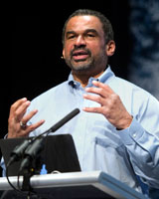
What are Sustainable Communities Anyway? What are We Aspiring to Create?
“Just sustainabilities is …‘the need to ensure a better quality of life for all, now and into the future, in a just and equitable manner, whilst living within the limits of supporting ecosystems’” - Julian Agyeman, Tufts University
SLS does not have one definition of a “sustainable community”
Rather, we bring diverse stakeholders together to continually create new visions of sustainable communities, and of the ways in which science and technology can help humans and nature flourish, now and in the future, in Georgia, the U.S., and around the globe
With our strong emphasis on Social Sustainability, including equity and voice, we align well with the definition of “Just Sustainabilities” above from Julian Agyeman, Professor of Urban and Environmental Policy and Planning at Tufts University, who is a leading scholar on the intersections between justice and sustainability and a co-founder of the concept of “just sustainabilities”

Slide 8
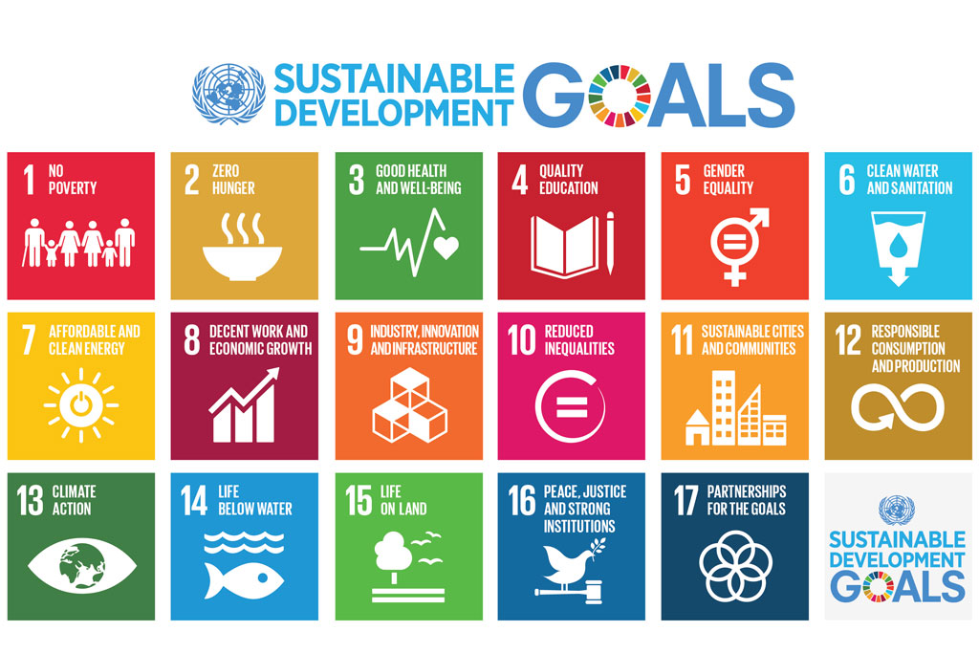
Our Ultimate Goal is to: Act Local to Achieve a Global Vision—U.N. SDGs
Learn more about our UN regional network: Greater Atlanta Regional Centre of Expertise on Education for Sustainable Development (RCE): serve-learn-sustain.gatech.edu/atlanta-un-rce

