Slide 1
Exploring Asset-Based Community Development:
The Tale of Two Cities
Adapted from ABCD Institute Toolkit from DePaul University
https://resources.depaul.edu/abcd-institute/resources/Pages/tool-kit.aspx

Slide 2
Let’s start with a thought exercise…
Notes:
In person, you will need to provide students with handouts of the A or B lists. Make sure you distribute a roughly even number of each list. Those handouts are included in the tool. In a virtual space, you can simply provide students with a link to one of the two lists via whatever sharing platform you typically use (sharepoint, google, etc).

Slide 3
You are invited by a community to come spend some time there so that you can advise their leadership on policy recommendations.
You have each received a list- marked either “A” or “B.” Please don’t show your list to anyone else yet. We are going to break into _ (based on the size of your class) groups, _ group/s of A people and _ group/s of B people.
You will have 15 minutes to discuss your lists and write down your recommendations. Please choose a spokesperson who will share your list with the rest of the group when we reconvene.
Notes:
It’s essential that students be able to see the contrasting recommendations of A and B groups as those groups share them out. If you are conducting this activity in person, it’s a great idea to have sheets of butcher paper or a dry-erase board so that you, the facilitator, can record the group’s recommendations so that the whole room can see them. If you are doing this activity in a virtual/remote space and using breakout rooms, then using a tool like jamboard (in the google suite) can work well. You can create a jamboard for each student group to use and which you can then all look out together as a class when you rejoin the main room. If jamboard isn’t a tool you know, then simply create a new slide in this deck that you can write on and show as students share out their recommendations.

Slide 4
Group A’s Observations/Data
This community is part of a large metropolitan city in a Southern state.
There are more people over 60 than under 18.
In the most recent government census, the population of this community was approximately 30,000 people.
The high school graduation rate is lower than in surrounding areas.
There are very few grocery stores- mostly quick marts and convenience stores.
Most of the commercial spaces are vacant.
There are poor sidewalks and very little public transportation infrastructure.
Many buildings have been tagged/display graffiti.
The mean income is lower than surrounding communities and unemployment is higher.
Those who do have jobs commute outside of the community to get to them.
Parts of the local creek are clogged with trash.
What were some recommendations you suggested based off of these general observations?
How did you go about making recommendations?
What were you focusing on?
Notes:
Get at least 5 recommendations from students

Slide 5
Group B’s Observations/Data
There is a neighborhood park with basketball courts and playgrounds.
Some of the buildings have murals and art from residents.
During the day, some residents gather in commercial parking lots to grill-out and eat together.
Many of the residents have lived there a longtime and trust each other.
Some of the residents keep chickens and sell their eggs.
Many men in the community are part of the same brotherhood/service society.
A creek runs through the community and in many places has sandy banks where local kids play.
There is a popular local library with a bank of computers, a few loaner laptops, and a dedicated staff.
This area has rich local history that is known by longtime residents, especially elder women.
There are several churches in the community.
Three empty lots get lots of sunshine and are within walking distance of the affordable housing for seniors.
What were some recommendations you suggested based off of these general observations?
How did you go about making recommendations?
What were you focusing on?
Notes:
Get at least 5 recommendations from students

Slide 6
These are observations of the SAME community
There is a neighborhood park with basketball courts and playgrounds.
Some of the buildings have murals and art from residents.
During the day, some residents gather in commercial parking lots to grill-out and eat together.
Many of the residents have lived there a longtime and trust each other.
Some of the residents keep chickens and sell their eggs.
Many men in the community are part of the same brotherhood/service society.
A creek runs through the community and in many places has sandy banks where local kids play.
There is a popular local library with a bank of computers, a few loaner laptops, and a dedicated staff.
This area has rich local history that is known by longtime residents, especially elder women.
There are several churches in the community.
Three empty lots get lots of sunshine and are within walking distance of the affordable housing for seniors.
This community is part of a large metropolitan city in a Southern state.
There are more people over 60 than under 18.
In the most recent government census, the population of this community was approximately 30,000 people.
The high school graduation rate is lower than in surrounding areas.
There are very few grocery stores- mostly quick marts and convenience stores.
Most of the commercial spaces are vacant.
There are poor sidewalks and very little public transportation infrastructure.
Many buildings have been tagged/display graffiti.
The mean income is lower than surrounding communities and unemployment is higher.
Those who do have jobs commute outside of the community to get to them.
Parts of the local creek are clogged with trash.
Now that you have the full list of observations, would any of your recommendations change? New ones you would add?
Notes:
Gabby will facilitate

Slide 7
Reflection
Whenever we go into a community, what we immediately see creates the baseline for our judgements about it - what is or isn’t “missing”
It is common for us to focus on what a community doesn’t have and letting that frame how we view that community - if we determine that “X” is missing, then that must be what the community “needs”
Making recommendations based on what the community lacks = needs based
Making recommendations based on leveraging what a community already has = asset based

Slide 8
Introducing ABCD:
THE DILEMMA
People and Communities
have deficiencies & needs
Individuals and Communities have assets and capacities
Notes:
ABCD is founded on the principle that all of us are like this glass – half full and half empty. We each have our gifts, talents and capacities as well as our problems, deficits and needs.
The same thing is true of neighborhoods,. They have assets and deficits.

Slide 9
NEIGHBORHOOD NEEDS MAP
Unemployment
Missing School
Broken Families
Slum Housing
Graffiti
Child Abuse
Gangs
Crime
Illiteracy
Mental Disability
Welfare Recipients
Lead Poisoning
Dropouts
Notes:
If you look at a neighborhood in terms of needs, this is how it looks.

Slide 10
EFFECTS OF A NEEDS APPROACH
Residents internalize labels (i.e. “We are deficient”)
Local relationships are damaged
Most money comes into community for (often) narrowly defined programs
Money can get misdirected towards professional helpers, not residents
Focus is placed on leaders who magnify community deficiencies
Failure is rewarded and residents become dependent on systems
Residents experience powerlessness and hopelessness
Notes:
While many institutions and funders focus neighborhoods on their needs, this approach to neighborhood development has many negative consequences.

Slide 11
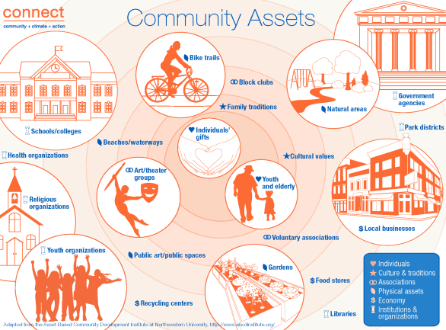

Slide 12
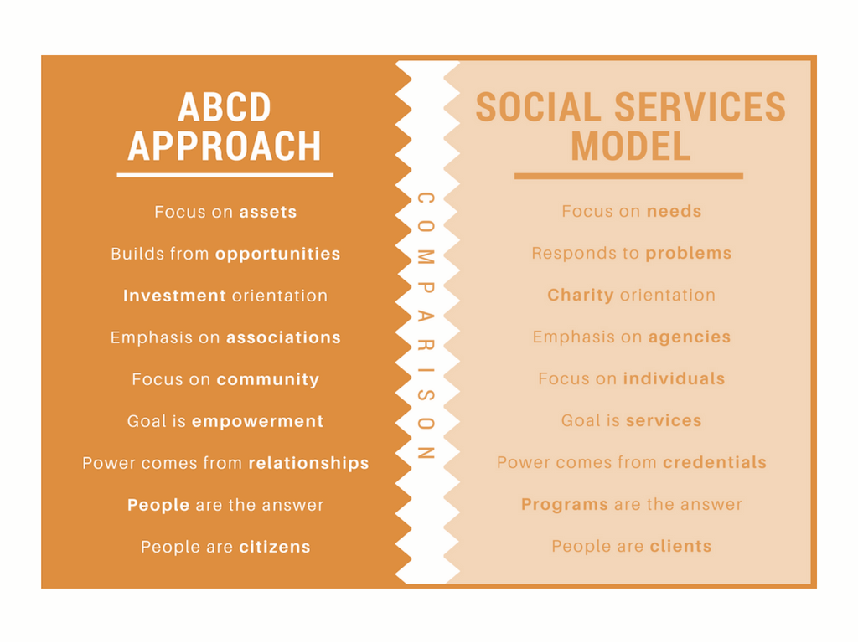

Slide 13
ABCD Principles
Every person and every community has gifts.
ABCD focuses especially on engaging gifts from marginalized people and groups.
Successful neighborhood action is the result of assets being identified - connected - and mobilized.
ABCD builds relationships among community members that are mutually supportive.
ABCD aims to give community members stronger roles in local social change work - which makes the change more sustainable.
There must be connectors to do this work - individuals, associations, and/or local institutions focused on building relationships and networks.
A B C D

Slide 15
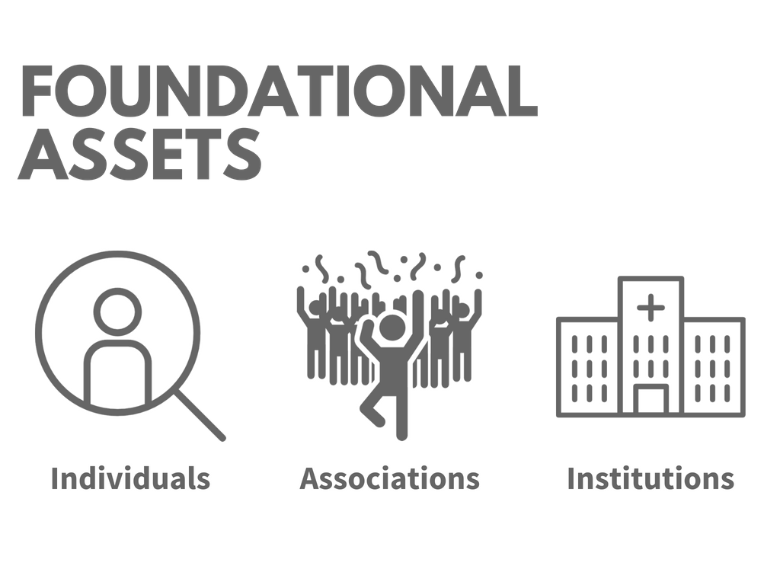

Slide 18
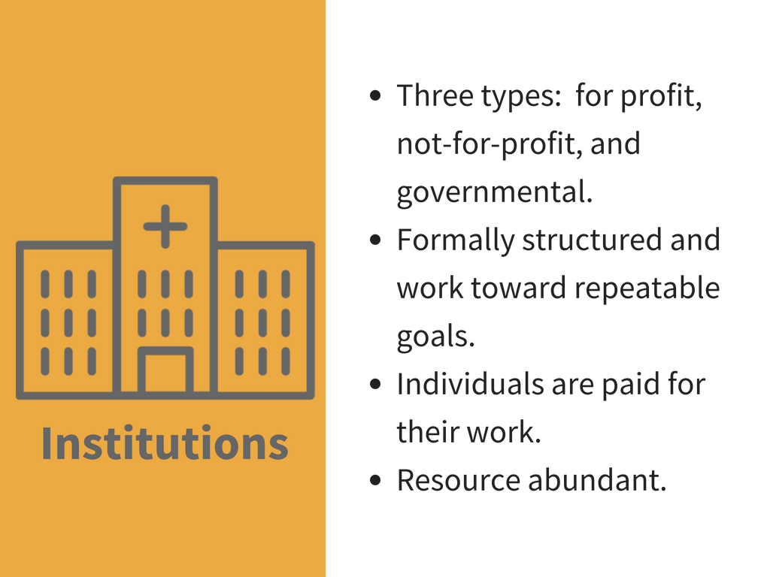

Slide 19
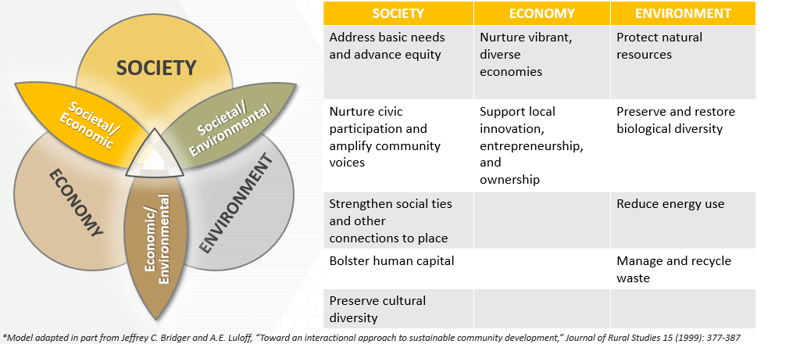
ABCD and Serve-Learn-Sustain
The ultimate goal is to create sustainable communities where people and nature flourish.
Notes:
--similarities to an asset map
Emphasis on people and gifts→ centering society
Society column will resonate as aspects of ABCD-
Economy: healthy and sustainable local economies rely on the characteristics described in sustainable society and environment, and vice versa
At the center- a thriving equitable community where assets are connected and mobilized, where people and nature flourish through that connectedness
Environment: this framework has, as we will see, similarities to an asset map. And like our emphasis tonight on people and their gifts, SLS takes an approach to sustainability that centers society and equity; the actions in the society column- advancing equity, nurturing civic participation, strengthening ties between people and between people and places and protecting cultural diversity are all aspects of asset based community development. And they are inseparable from assets that characterize healthy and sustainable local economies and the flourishing of the environment through the actions like the management and preservation of resources and the protection of biological diversity.

Slide 20
Some of our favorite ABCD resources
The Asset-Based Community Development Institute at DePaul University (loads of resources on this site)
ABCD Basic Slide Presentation with Notes from The ABCD Institute
“What is Asset-based Community Development (ABCD)” from the Collaborative for Neighborhood Transformation
“The New Paradigm for Effective Community Development - Asset-based” by ABCD Institute Steward Dan Duncan
"Building 21st Century Communities" by ABCD Institute Faculty Member Jim Diers - likely of special interest to planners, as Jim was the first director of Seattle's Department of Neighborhoods in 1988 (see also his Neighbor Power book website here)
Sustainable Community Development: From What’s Wrong to What’s Strong – TED-X talk by ABCD Institute Steward Cormac Russell
Asset-based Approaches to Engaging Communities in Sustainability – see links to a variety of resources from SLS Director and ABCD Institute Steward Jennifer Hirsch

