Slide 1
INTRODUCTION TO CLIMATE RESILIENCE
Created by Bonnie Lapwood & Ben Shipley

Slide 2
WHAT IS CLIMATE RESILIENCE?
Climate resilience encompasses efforts in multiple fields to address climate vulnerability – the extent to which human and ecological systems will be affected by the changes wrought by global climate change – through assessment of vulnerability and the development of strategies for adaptation.
Climate resilience definitions vary somewhat, depending on the systems that are being examined and the disciplinary perspectives used to examine them.

Slide 3
MULTIPLE DEFINITIONS OF RESILIENCE
The idea of “resilience” arose in an ecological context but has been re-defined and re-imagined over the last several decades, depending on the field of study and area of focus.
Ecological
“The capacity of a system to experience shocks while retaining essentially the same function, structure, feedbacks, and therefore identity” (Walker)
Social Sciences
“The ability of groups or communities to cope with external stresses and disturbances as a result of social, political, and environmental change” (Adger)
Hybrid
“Measure of the persistence of systems and of their ability to absorb change and disturbance and still maintain the same relationships between populations or state variables” (Holling)
“The ability of the system to withstand either market or environmental shocks without loosing the capacity to allocate resources efficiently” (Perrings)
“The underlying capacity of an ecosystem to maintain desired ecosystem services in the face of a fluctuating environment and human use” (Folke)
"The capacity of a social-ecological systems to absorb recurrent disturbances (...) so as to retain essential structures, processes and feedbacks" (Adger)
Adapted from Brand & Jax¹

Slide 4
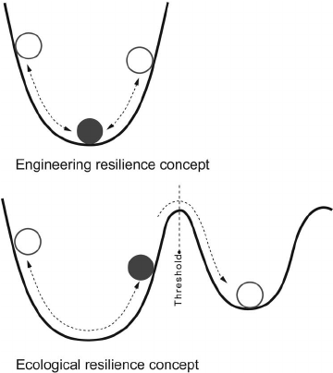
MULTIPLE DEFINITIONS OF RESILIENCE
“Engineering resilience” usually refers to the capacity of a system to maintain its function in the face of stress²
“Ecological resilience” refers to the ability of a system to shift between alternate stable states after a threshold of stress is reached³
Adapted from Liao⁴

Slide 5
MULTIPLE DEFINITIONS OF RESILIENCE
“Cities are resilient when they can persist, adapt, and transform in the face of stress and shocks” – David Iwaniec²
The idea of “bouncing forward” describes a notion of resilience where systems do not simply return to the status quo after a stress or shock but instead achieve additional capacity to resist in the future.⁴ In addition to being simply “adaptive,” resilient systems are thus “transformative.”⁵

Slide 6
KEY CONCEPTS OF CLIMATE RESILIENCE
Climate change can and will cause large and small stresses to existing social and environmental systems.
Climate resilience refers to the ability of these systems to withstand and regenerate themselves in the face of these stresses.
Climate vulnerability is the degree to which systems can be disrupted or transformed by the effects of climate change.
Attempting to understand and measure climate vulnerability of different systems allows for the development of strategies for adaptation and transformation.
A resilience perspective acknowledges the integrated nature of societal, economic, and environmental systems.

Slide 7
WHY RESILIENCE?
“As humans struggle to manage key ecosystem attributes of function and pattern, there is a growing recognition of the importance of ecological resilience. Ecological resilience is recognized as the property that allows for managers and other actors to learn from and adapt to the unpredictability inherent in these ecosystems.”
- Lance Gunderson⁶

Slide 8
WHY RESILIENCE?
“In a resilient social–ecological system, disturbance has the potential to create opportunity for doing new things, for innovation and for development. In vulnerable systems even small disturbances may cause dramatic social consequences.”
- Carl Folke³

Slide 9
WHY RESILIENCE?
“The resilience approach is systems orientated, takes a more dynamic view, and sees adaptive capacity as a core feature of resilient social-ecological systems. Adaptation is a process of deliberate change in anticipation of or in reaction to external stimuli and stress.”
- Donald R. Nelson, W. Neil Adger, and Katrina Brown⁷

Slide 10
INTEGRATED SYSTEMS
An Integrated Approach to Sustainability
Approaches to assessing climate vulnerability and developing climate resilience can focus on various systems in the realms of environment, economy, and society.
An integrated framework views these domains as overlapping and intersecting, with impacts in one sphere affecting those in other spheres.
Environment
Economic/ Environmental
Environmental/ Societal
Economy
Society
Societal/Economic

Slide 11
INTEGRATED SYSTEMS
Social
Technological
Ecological
Social-Ecological-Technological Systems (SETS) Framework
Another way of conceptualizing different system interactions within the context of resilience is acknowledging the confluence of social, ecological, and technological systems and their interactions and feedbacks.²

Slide 12
UNDERSTANDING VULNERABILITY
Exposure
The Intergovernmental Panel on Climate Change (IPCC) identifies three elements to vulnerability: exposure, sensitivity, and adaptive capacity.⁸
Exposure is contact with one or more physical, biological, chemical, or psychosocial stressors.
Sensitivity is the degree to which exposure affects an organism, structure, or system.
Adaptive capacity is the ability of the system to adjust to or cope with potential hazards.⁹
Sensitivity
Vulnerability
Adaptive capacity

Slide 13
WHAT IS ADAPTATION?
“We define adaptation as the decision-making process and the set of actions undertaken to maintain the capacity to deal with future change or perturbations to a social-ecological system without undergoing significant changes in function, structural identity, or feedbacks of that system while maintaining the option to develop.”
- Donald R. Nelson, W. Neil Adger, and Katrina Brown⁷

Slide 14
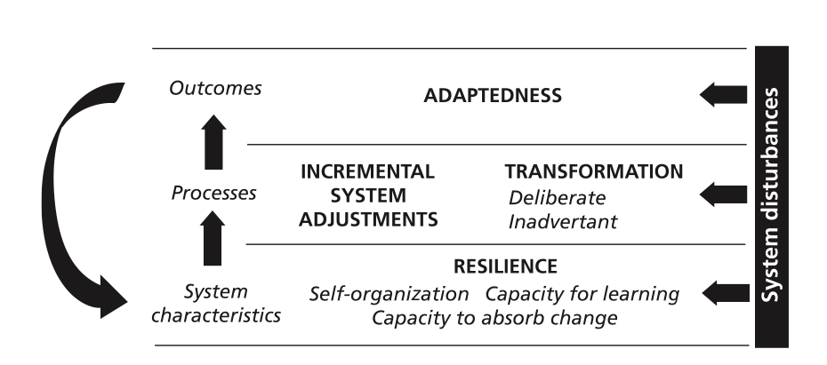
WHAT IS ADAPTATION?
Adaptation consists of “adjustments in natural or human systems in response to expected or actual climatic stimuli or their effects, which moderates harm.”⁸
Diagram from Nelson, Donald R., Adger, W. Neil, and Brown, Katrina. “Adaptation to Climate Change: Contributions of a Resilience Framework.”⁷

Slide 15
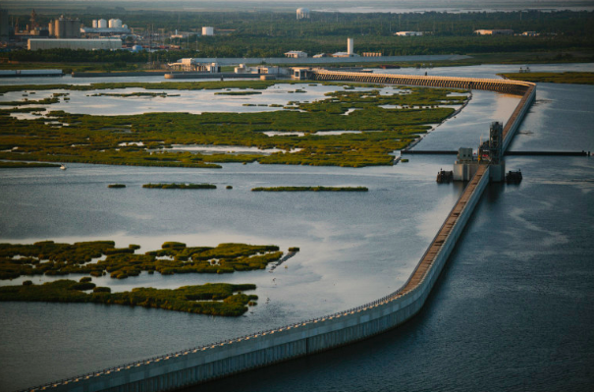
EXAMPLES: HURRICANE KATRINA
Vulnerability is increased by New Orleans’ location among low-lying wetlands, poorly engineered levees, and neighborhoods living in poverty.
Adaptation would include rebuilding in a way that aims to reduce these vulnerabilities: relocation, better levee engineering, mitigation of gentrification, and reduction of poverty and racial segregation.
Resilience is increased by planning for future hazards with a protocol that includes adaptive strategies and a clear allocation of governmental responsibilities.
- Heike Schroeder and Dayna Yocum¹⁰
Photo from Edmund D. Fountain, The Lens NOLA.

Slide 16
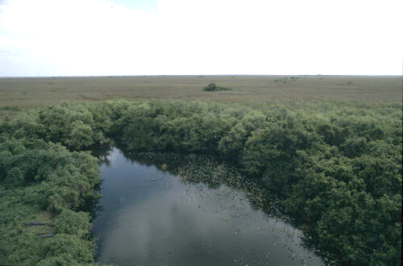
EXAMPLES: EVERGLADES
Vulnerability of the Everglades is increased by agricultural runoff (especially phosphorus).
Adaptation to runoff is characterized by a shift from sawgrass marshes to marshes dominated by cattails (alternate stable states).
Resilience of the sawgrass marshes is increased by reducing agricultural runoff and clearing of marshes, as well as increasing plant diversity in the marshes.
- Lance Gunderson⁶
Photo from David Geldhof.

Slide 17
REFERENCES
Brand, Fridolin Simon, and Jax, Kurt. “Focusing the Meaning(s) of Resilience: Resilience as a Descriptive Concept and a Boundary Object.” (2007).
Iwaniec, David. “Lecture on A Social-Ecological-Technological System (SETS) Approach to Advancing Urban Systems Science.” (2020).
Folke, Carl. "Resilience: The emergence of a perspective for social–ecological systems analyses." (2006).
Liao, Kuei-Hsien. “A Theory on Urban Resilience to Floods—A Basis for Alternative Planning Practices.” (2012).
McPherson, Timon, Iwaniec, David M., and Bai, Xumei. “Positive visions for guiding urban transformations toward sustainable futures.” (2016).
Gunderson, Lance. “Ecological Resilience—In Theory and Application”. (2001)
Nelson, Donald R., Adger, W. Neil, and Brown, Katrina. “Adaptation to Climate Change: Contributions of a Resilience Framework.” (2007).
IPCC. “Determinants of Risk: Exposure and Vulnerability.” (2012).
IPCC. “Fourth Assessment Report.” (2007).
Schroeder, Heike and Yocum, Dayna. “Vulnerability, Resilience, and Adaptation: Response Mechanisms in an Environmental Emergency – The Asian Tsunami in Thailand and Hurricane Katrina in the United States.” (2006).
Meerow, Sara and Stuits, Melissa. “Comparing Conceptualizations of Urban Climate Resilience in Theory and Practice.” (2016).
Stone, Brian. Lecture on Climate and Health. (2020).

Slide 18
Find more tools
https://serve-learn-sustain.gatech.edu/teaching-toolkit

