Slide 1
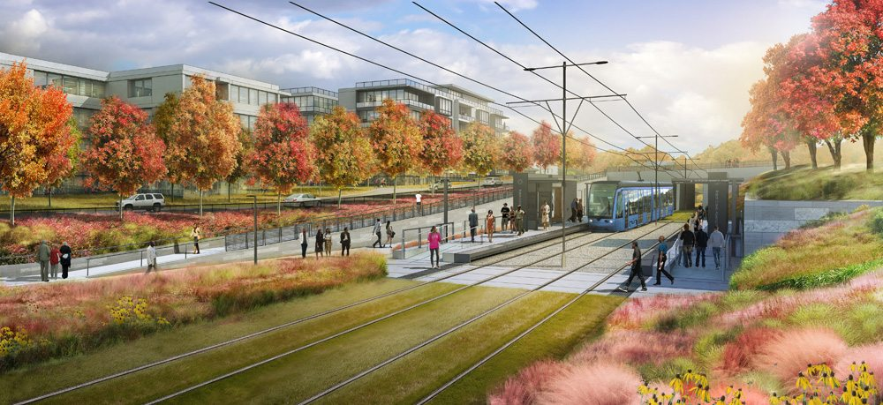
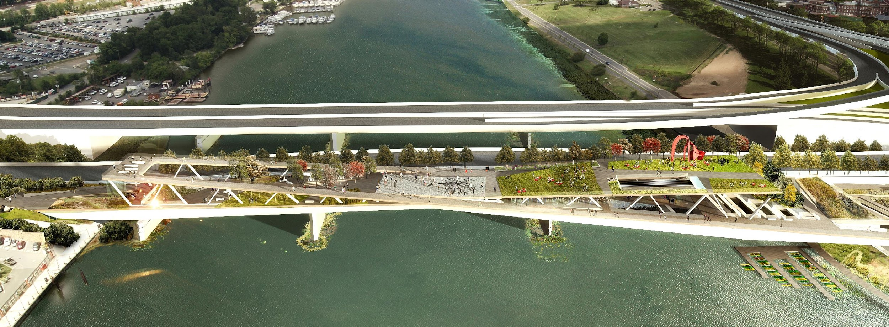
An Introduction to
Green Infrastructure
Notes:
Role of social capital in supporting more equitable development surrounding green infrastructure

Slide 2
Initial Activity:
You see three big “post-its” on the wall of this classroom- labelled, “Examples of Green Infrastructure,” “Examples of Equality” and “Examples of Equity.” Please use the (little!) post-it notes provided to you to write an example of each (to the best of your ability!). Then stick them on on the appropriate (big) post-it note. As you write, think about how these three concepts are connected.

Slide 3
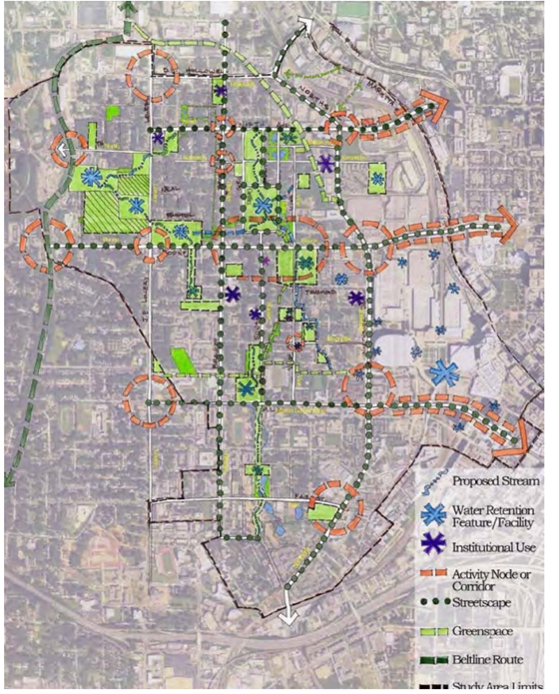
Defining Green Infrastructure
An interconnected, multifunctional network of greenspace and natural areas that shapes and is shaped by communities’ environmental, economic, social, and health qualities
May refer to a wide array of natural features, engineered structures, or managed interconnected networks of green space and their associated ecosystem services, including:
Parks
Stormwater management features
Greenways and trails
Green streets
Watershed restoration projects
Image: Park Pride, Proctor Creek North Avenue Green Infrastructure Vision

Slide 4
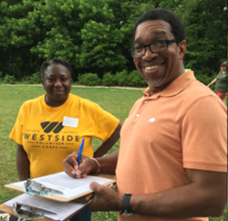
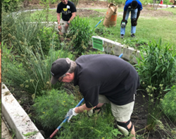
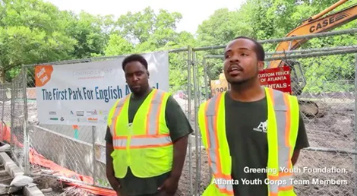
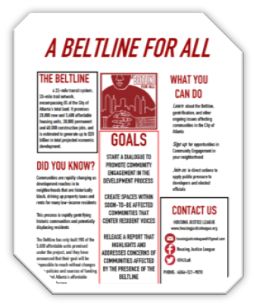
Defining Green Infrastructure
"If we think the stormwater and green infrastructure concerns are just about the blue and the green, we have sadly missed the mark.
These issues must be people-centered.”
-Proctor Creek Watershed Resident
Images: Greening Youth Foundation, West Atlanta Watershed Alliance, Housing Justice League

Slide 5
Why Green Infrastructure?
Environmental, economic, and social opportunities for communities
Environmental | Economic | Social
Stormwater management (Hoyer, Dickhaut, Kronawitter, and Weber, 2011) Air/water purification (Hoyer, Dickhaut, Kronawitter, and Weber, 2011) Climate change adaptation (Gill, Handley, Ennos, and Pauleit, 2007, Stone, 2012, Norton et al, 2012) Remediation (Ahern, 2007) Protection of natural areas/ buffer (Forman, 2008, Ahern, 2007) Biodiversity protection and support (Tzoulas et al., 2007, Forman, 2008) Green transportation (Conine, Xiang, Young, and Whitley, 2004) Urban design/ livability (Beatley, 2011) | Local economic development (Daniels, 2008) Job creation/ training (Schilling and Logan, 2008) Green transportation (Conine, Xiang, Young, and Whitley, 2004) Food production (Agyeman, 2013) Drawing talent with increased quality of life (Daniels, 2008) Cost savings relative to grey infrastructure (Rouse and Bunster-Ossa, 2013) Reductions in car commuting (Vandermuellen et al, 2011) Health impacts (Vandermuellen et al, 2011) | Social/ cultural opportunities (Ahern, 2007) Experiences of natural ecosystems (Ahern, 2007) Recreation (Ahern, 2007) Public/ mental health (Beatley, 2011, Chawla, 2015, Cheisura, 2004) Education (Ahern, 2007) Community empowerment and advocacy (Wilker and Rymsa-Fitschen, 2016, Anguelovski, 2015) Overlap with environmental and economic impacts

Slide 6
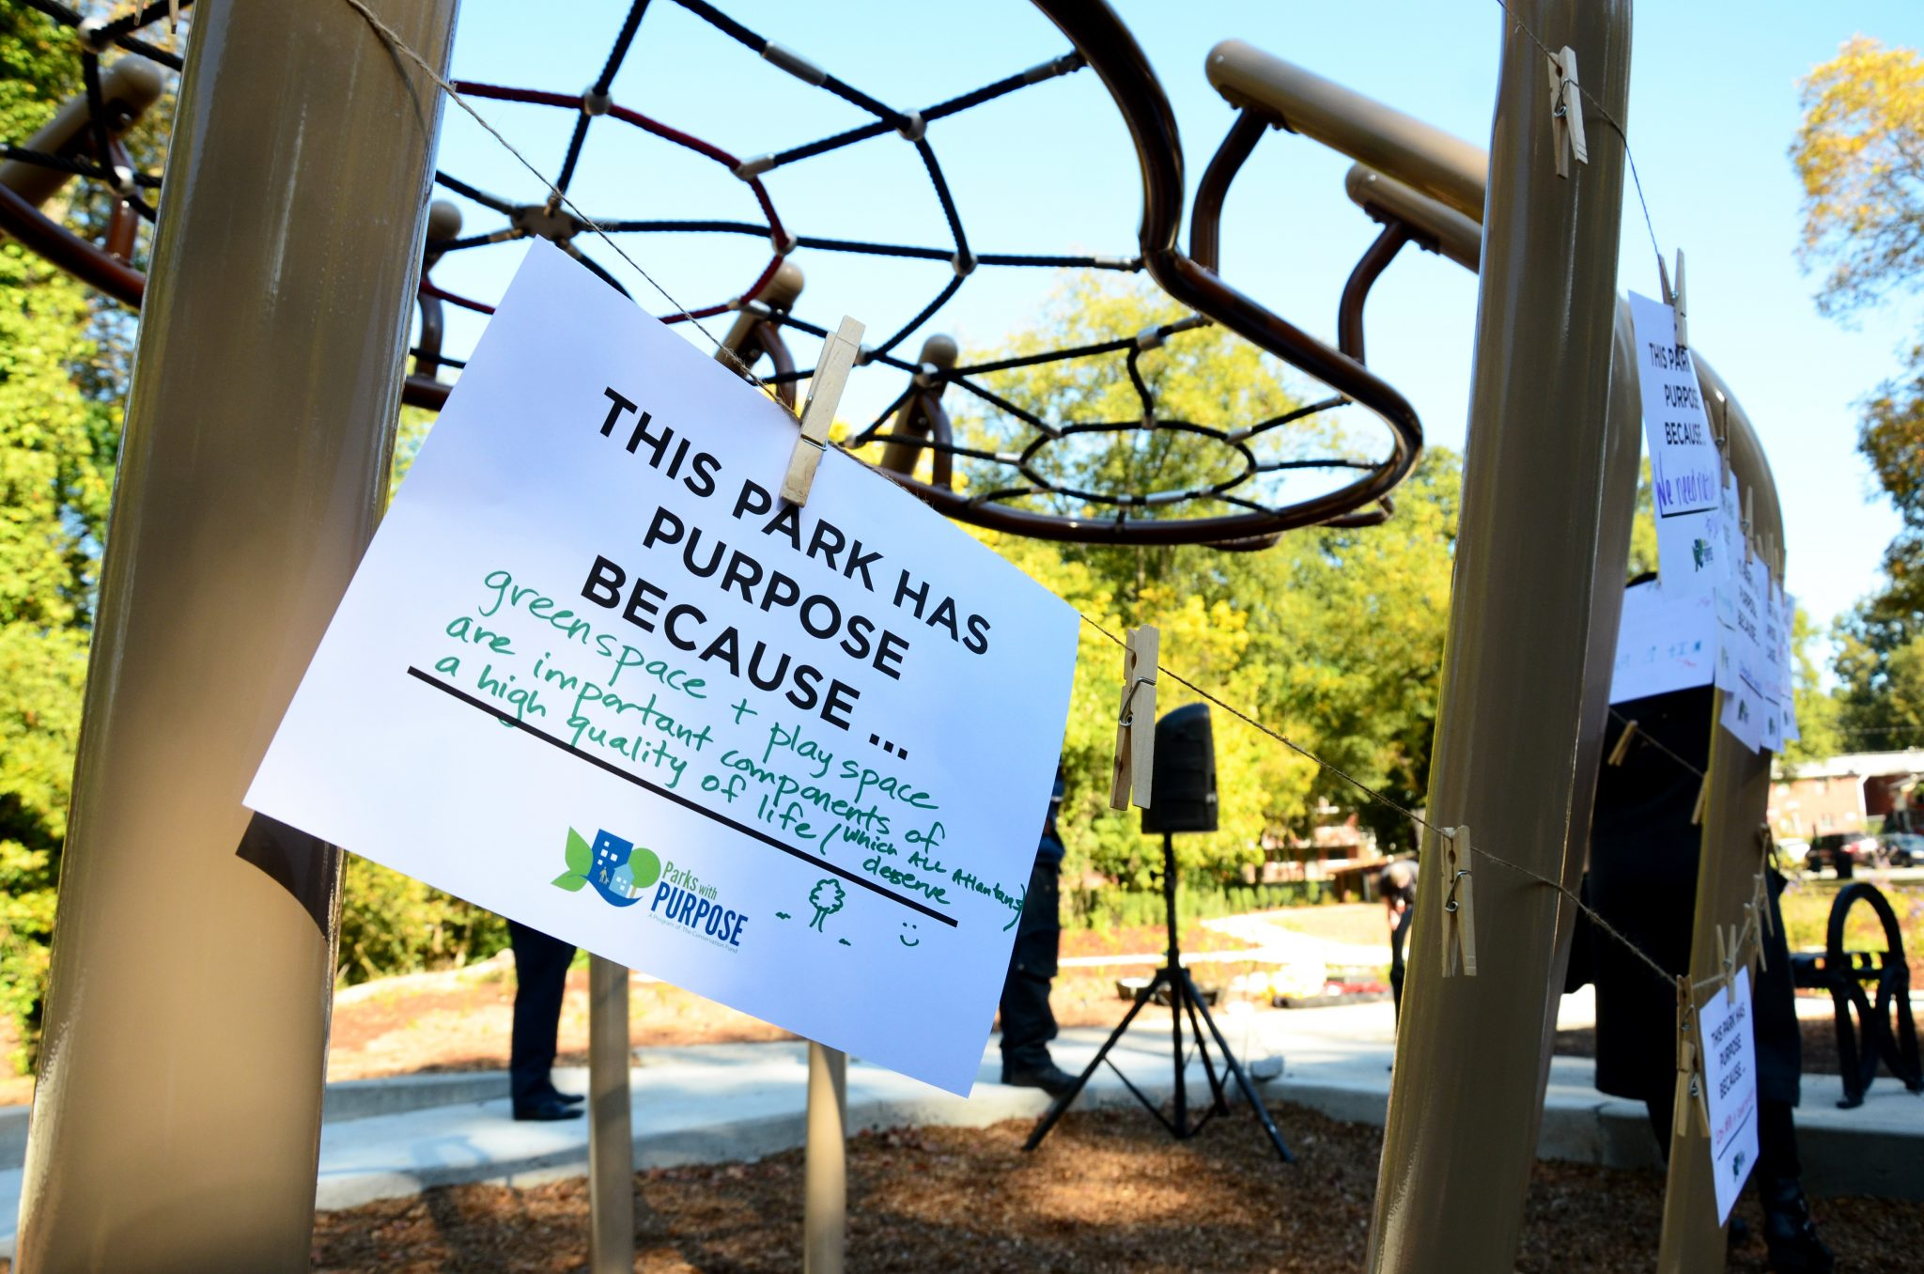
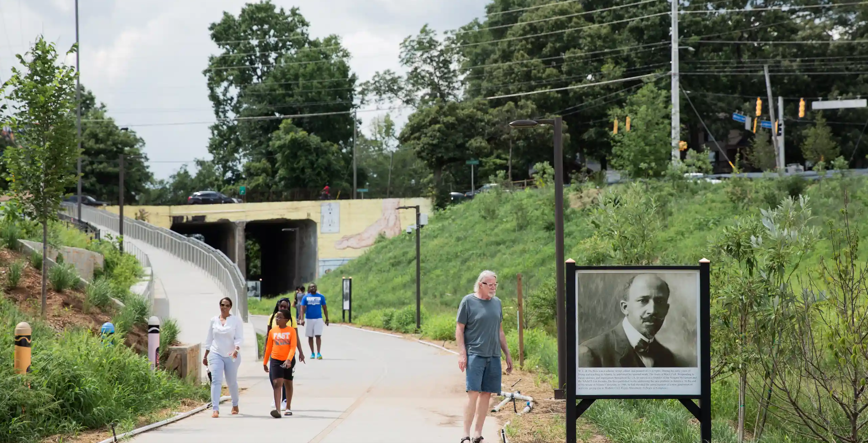
Why Green Infrastructure?
Potential to address environmental justice threats and provide access to environmental, economic, and social amenities
Many GI outcomes are of particular importance in low-income, high-poverty neighborhoods, which often suffer from a lack of public investment and environmental justice concerns.
These aspects make GI an important investment as cities seek to address environmental and equity concerns, particularly in low-income neighborhoods suffering from disinvestment.
Images: Pond and Co., The Guardian

Slide 7
Green Infrastructure Key Concepts
1 | Green infrastructure has environmental, economic, and social impacts. These impacts drive government agencies, nonprofits, community groups, and others to invest in green infrastructure.
2 | In improving environment and health qualities, green infrastructure may drive gentrification and displacement in vulnerable communities.
3 | Green infrastructure can support the development of community social capital, which in turn shapes how projects impact communities.
4 | Meaningful community participation in planning for green infrastructure is vital to ensuring projects benefit and empower communities.
5 | The broader political context (e.g., affordable housing policies/ programs/ funding, community engagement requirements) in which green infrastructure is implemented shapes the outcomes of green infrastructure projects.

Slide 8
Counting Off: Green Infrastructure Key Concepts
1 | What is an example of a social impact?
2 | What is the relationship between gentrification and displacement?
3 | What does “community social capital” mean?
4 | What is an example of “meaningful community participation”?
5 | How does political context shape equity outcomes for GI?

Slide 9
Green Infrastructure Conceptual Model
Social + Community
Green Infrastructure multifunctional, interconnected
networks of greenspace
Political Context; Race and Income
Environment + Health
Housing +
Economic Development
Impact on Community Empowerment, Quality of Life, and Wellness

Slide 10
Green Infrastructure and
Environment/ Health
Green Infrastructure multifunctional, interconnected
networks of greenspace
Environment + Health
Impact on Community Empowerment, Quality of Life, and Wellness
Environmental justice threats such as flooding create a need for green infrastructure.
Green infrastructure shapes environment and health qualities by addressing environmental justice goals of:
Protection from environmental pollution
Right to live in and enjoy a clean and healthful environment
Equitable distribution of environmental benefits
Equal protection and meaningful involvement of all people (Agyeman and Evans, 2003, and Commonwealth of Massachusetts, 2002)

Slide 11
Green Infrastructure and
Housing/ Economic Development
Green Infrastructure multifunctional, interconnected
networks of greenspace
Housing +
Economic Development
Impact on Community Empowerment, Quality of Life, and Wellness
Communities may invest in green infrastructure to support economic development in neighborhoods that have experienced disinvestment.
Green infrastructure can support local economic development by:
Attracting workers and employers
Providing opportunities for food production
Creating green jobs (Daniels, 2008)
It may also drive increases in housing values and costs, leading to displacement of residents and environmental gentrification. (Dooling, 2008, Wolch, Byrne, and Newell, 2014)

Slide 12
Green Infrastructure and Community
Green Infrastructure multifunctional, interconnected
networks of greenspace
Social + Community
Impact on Community Empowerment, Quality of Life, and Wellness
Green infrastructure can:
Provide social and recreational opportunities, experience with nature, educational opportunities, and cultural experiences (Ahern, 2007)
Attract a variety of stakeholders to planning processes (Rouse and Bunster-Ossa, 2013)
Empower communities through collaborative planning for project design and implementation (Wilker and Rymsa-Fitschen, 2016)
Catalyze advocacy around environmental justice and housing affordability (Anguelovski, 2015)
Community engagement shapes green infrastructure projects and their outcomes (Fisch, 2019)

Slide 13
Green Infrastructure Contexts
Issues of race and income shape how investments in green infrastructure impact communities (e.g., lower-income communities are more vulnerable to displacement)
Political Context; Race and Income
The broader political context in which green infrastructure is implemented in communities shapes projects’ economic and social outcomes. This includes aspects such as:
Affordable housing policies, programs, and funding
Community benefits programs, such as workforce training and local hiring
Standards for community engagement and participation
Number and connectedness of institutions focused on equitable development
Supportive political contexts are important for ensuring projects benefit communities

Slide 14
Green Infrastructure Conceptual Model
Social + Community
Green Infrastructure multifunctional, interconnected
networks of greenspace
Political Context; Race and Income
Environment + Health
Housing +
Economic Development
Impact on Community Empowerment, Quality of Life, and Wellness

Slide 15
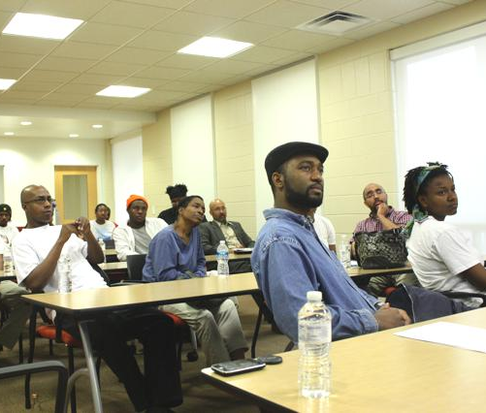
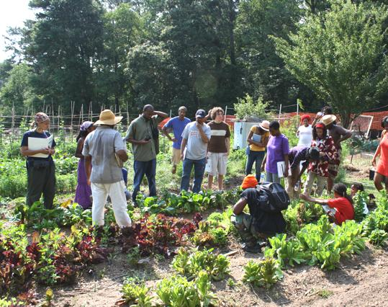
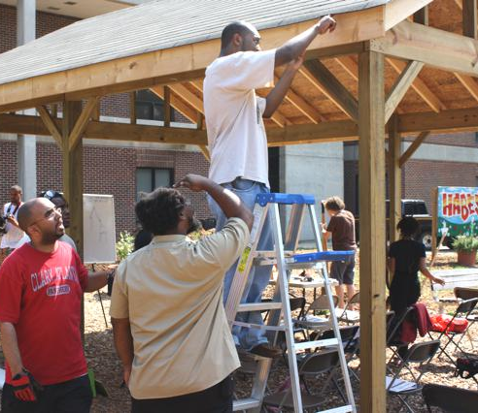
An Atlanta Example: HABESHA Works
Green jobs training initiative that teaches basic skills in urban organic agriculture, agro-business development, and green infrastructure
Objectives:
Skills and professional development training in sustainable agriculture and green infrastructure for young adults
Community-based approach to health disparities by training individuals to produce and distribute organically grown vegetables and implement green infrastructure
Economic development model that creates social entrepreneurship opportunities for participants to continue utilizing their training
Images: HABESHA Works

Slide 16
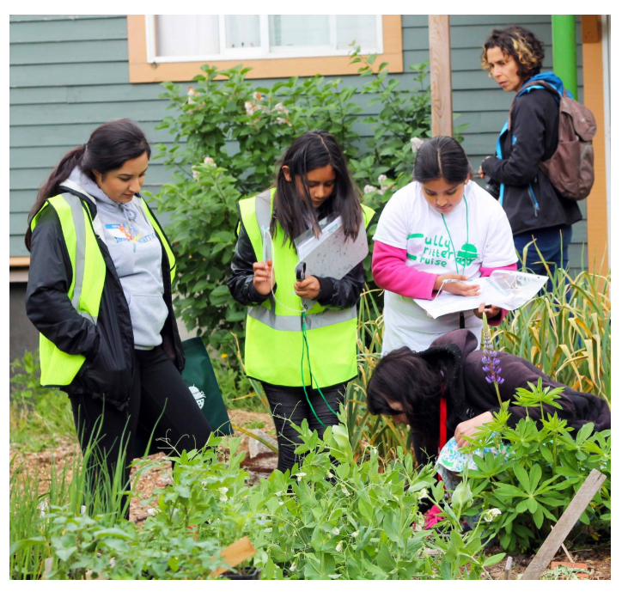
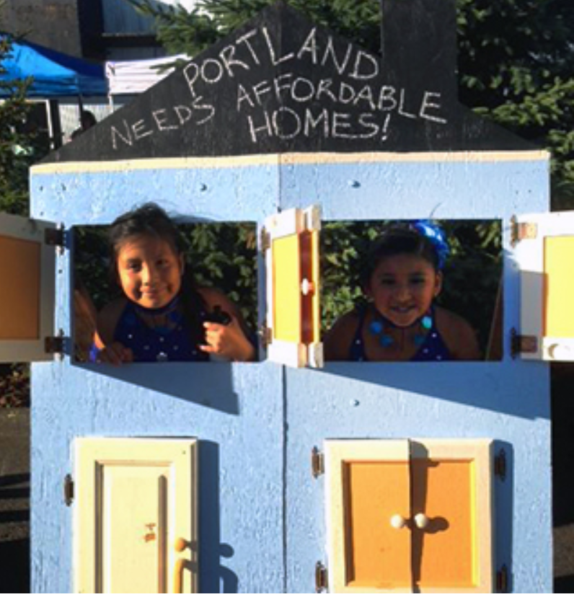
Portland’s ‘Living Cully’
A robust network of community organizations and resident leaders that reinterprets sustainability as an anti-poverty strategy
Concentrates environmental investments at the neighborhood scale and combines them with traditional community development resources
Projects include:
Development of a new park from a former landfill site
Community wayfinding/ signage
Environmental education for youth
Community leadership and capacity building
Local hiring/ workforce training
Affordable housing
Home retrofits
Transportation advocacy
Community energy plan
Images: Living Cully

Slide 17
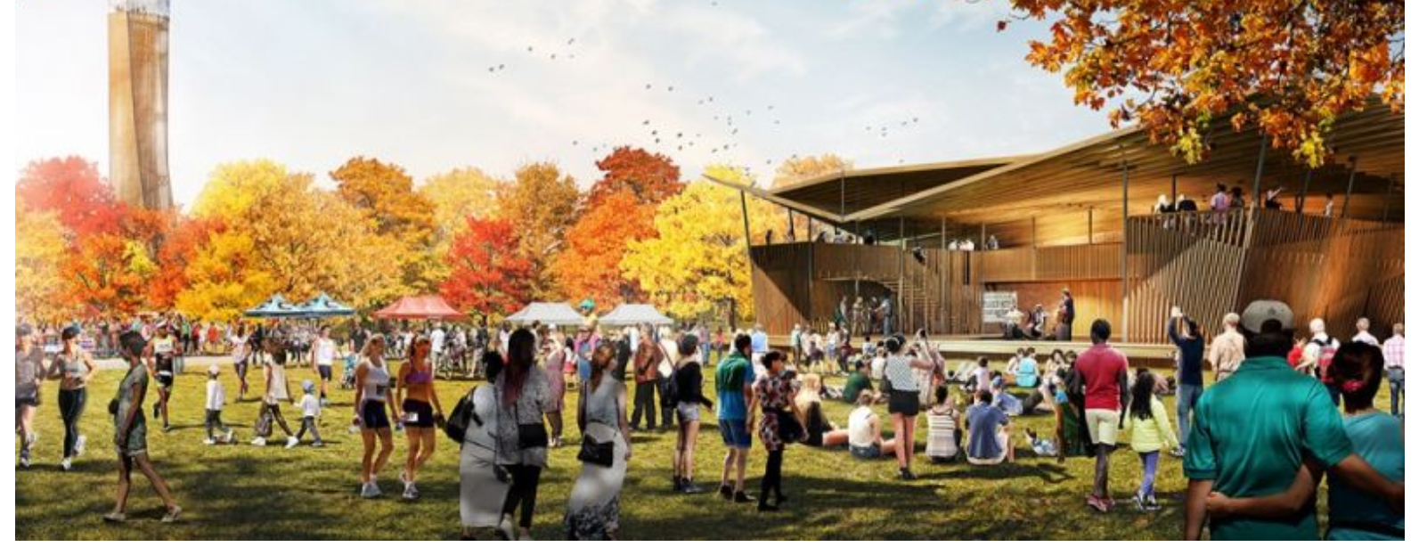
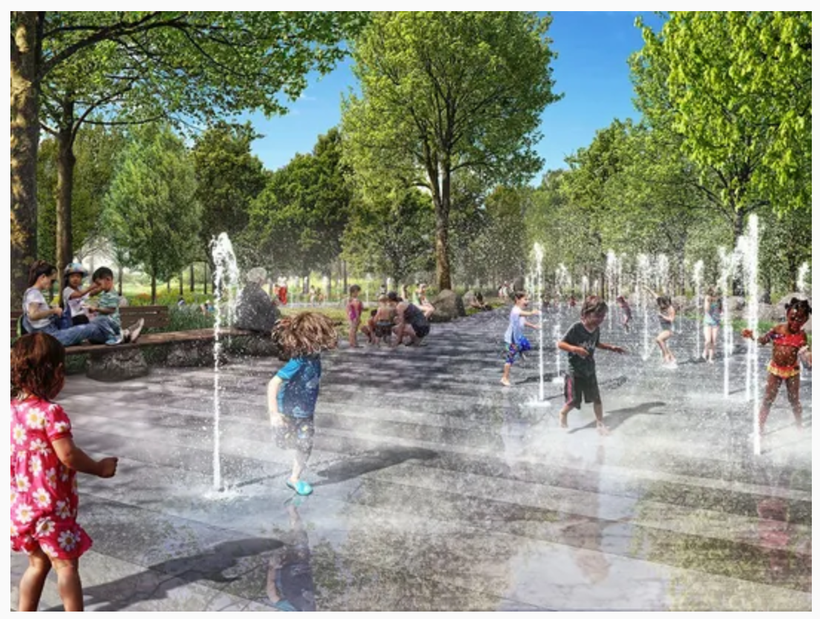
Greenville, SC’s Unity Park
Constructed at the site of a formerly segregated park as a symbol of inclusivity
Land around the park earmarked for affordable housing (overseen by the Greenville Housing Fund) with the goal of limiting gentrification and displacement
Collaboration with the Southernside neighborhood association and other stakeholders with interest in keeping the area diverse and inclusive
The area’s history will be incorporated through interpretive signage telling the story of the once-segregated park
Images: Next City, Greenville News

Slide 18
References
Agyeman, J. (2013). Introducing just sustainabilities: Policy, Planning, and Practice. Zed books.
Agyeman, J., Bullard, R. D., & Evans, B. (Eds.). (2003). Just sustainabilities: Development in an unequal world. MIT press.
Ahern, J. (2007). Green infrastructure for cities: the spatial dimension. In. In Cities of the future: Towards integrated sustainable water and landscape management. IWA Publishing.
Anguelovski, I. (2015). From Toxic Sites to Parks as (Green) LULUs? New Challenges of Inequity, Privilege, Gentrification, and Exclusion for Urban Environmental Justice. Journal of Planning Literature, 0885412215610491.
Beatley, T. (2011). Biophilic cities: integrating nature into urban design and planning. Island Press.
Benedict, M. A., McMahon, E. T. (2006). Green infrastructure: Linking landscapes and communities. Washington, DC: Island Press.
Chawla, L. (2015). Benefits of nature contact for children. CPL bibliography, 30(4), 433-452.
Chiesura, A. (2004). The role of urban parks for the sustainable city. Landscape and urban planning, 68(1), 129-138.
Commonwealth of Massachusetts. (2002). Environmental justice policy. State House, Boston, MA
Conine, A., Xiang, W. N., Young, J., & Whitley, D. (2004). Planning for multi-purpose greenways in Concord, North Carolina. Landscape and Urban Planning, 68(2), 271-287.
Daniels, T. (2008). Taking the initiative: why cities are greening now. In Birch, E. L., & Wachter, S. M. (2008). Growing greener cities: Urban sustainability in the twenty-first century. Philadelphia: University of Pennsylvania Press.
Dooling, S. (2008). Ecological gentrification: Re-negotiating justice in the city. Critical Planning, 15, 40-57.
Fisch, J. (2019). Does green infrastructure promote equitable development? The mediating role of social capital in shaping impacts.
Forman, R. T. (2008). Urban regions: ecology and planning beyond the city. Cambridge University Press.
Gill, S. E., Handley, J. F., Ennos, A. R., & Pauleit, S. (2007). Adapting cities for climate change: the role of the green infrastructure. Built environment, 33(1), 115-133.
Hoyer, J., Dickhaut, W., Kronawitter, L., & Weber, B. (2011). Water sensitive urban design: principles and inspiration for sustainable stormwater management in the city of the future. Hamburg, Germany: Jovis.
Norton, B. A., Coutts, A. M., Livesley, S. J., Harris, R. J., Hunter, A. M., & Williams, N. S. (2015). Planning for cooler cities: A framework to prioritise green infrastructure to mitigate high temperatures in urban landscapes. Landscape and Urban Planning, 134, 127-138.
Rouse, D. C., & Bunster-Ossa, I. F. (2013). Green infrastructure: a landscape approach (No. 571).
Schilling, J., & Logan, J. (2008). Greening the rust belt: A green infrastructure model for right sizing America's shrinking cities. Journal of the American Planning Association, 74(4), 451-466.
Stone Jr, B. (2012). The city and the coming climate: climate change in the places we live. Cambridge University Press.
Tzoulas, K., Korpela, K., Venn, S., Yli-Pelkonen, V., Kaźmierczak, A., Niemela, J., & James, P. (2007). Promoting ecosystem and human health in urban areas using Green Infrastructure: A literature review. Landscape and urban planning, 81(3), 167-178.
Vandermeulen, V., Verspecht, A., Vermeire, B., Van Huylenbroeck, G., & Gellynck, X. (2011). The use of economic valuation to create public support for green infrastructure investments in urban areas. Landscape and Urban Planning, 103(2), 198-206.
Wilker, J., Rusche, K., & Rymsa-Fitschen, C. (2016). Improving participation in green infrastructure planning. Planning Practice & Research, 31(3), 229-249.
Wolch, J. R., Byrne, J., & Newell, J. P. (2014). Urban green space, public health, and environmental justice: The challenge of making cities ‘just green enough’. Landscape and Urban Planning, 125, 234-244.

