Slide 1

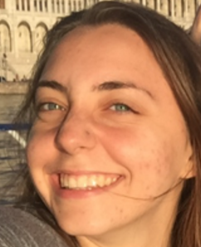
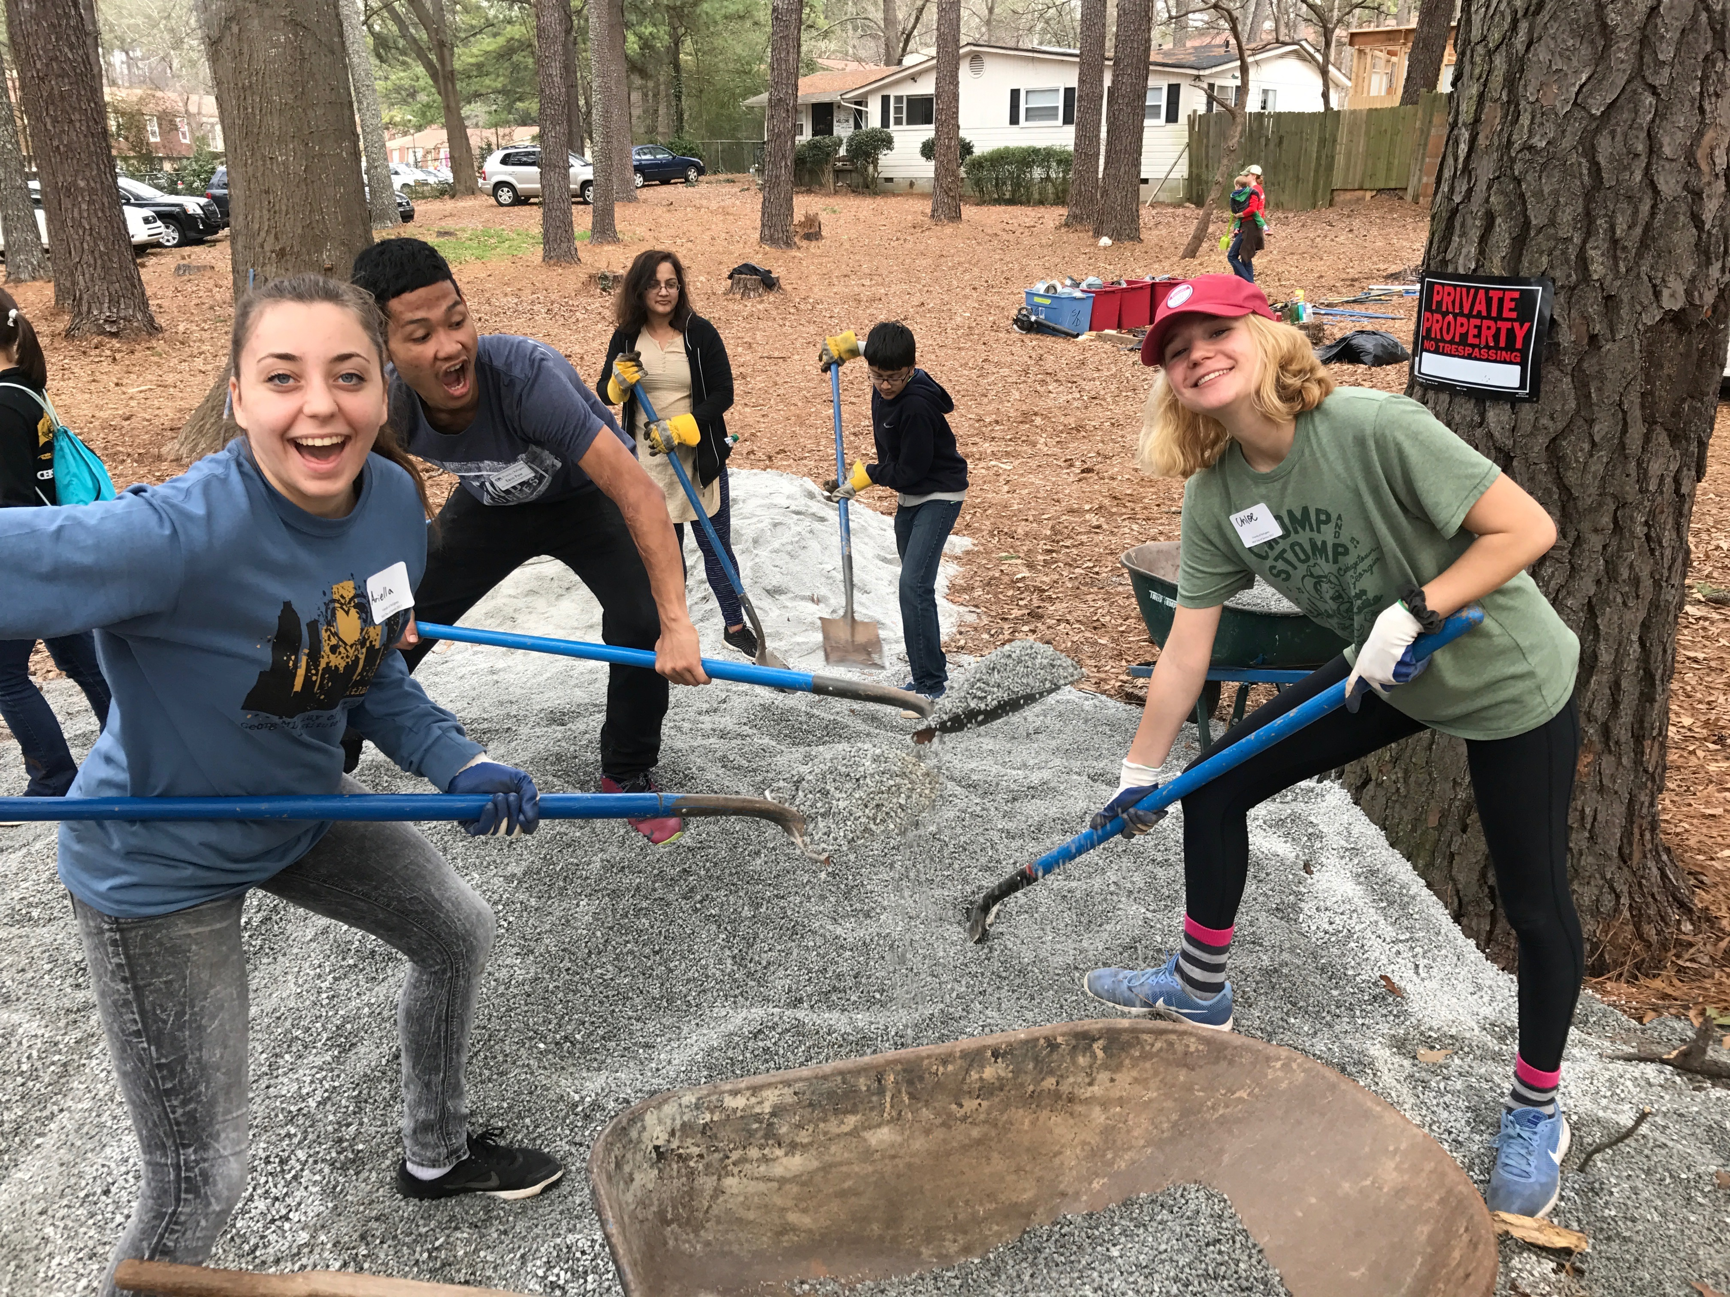
Student profile
Ariella Ventura, ISyE, 2020
“SLS has taught me to look at issues from multiple viewpoints. My SLS class is taught by three professors of differing backgrounds. Each class, my professors frame sustainability using their interdisciplinary knowledge, allowing me to better understand the complexity of real life problem solving.”
Summer 2016: Participates in SLS-affiliated Leadership for Social Good Study Abroad in Eastern Europe (Scheller); first hears about SLS through SLS guest lecture during orientation; writes SLS blog post from abroad
Fall 2016: Starts participating in events/service days with an engaged friend
Spring 2017: Takes SLS foundation course; continues to attend events
AY2018 and beyond: Takes more SLS courses and pursues minor in SLS or Sustainable Cities (SCaRP)
Career Interest: Improve city systems, like transit, through sustainability
MLK Day of Service in Clarkston
Notes:
***

Slide 2
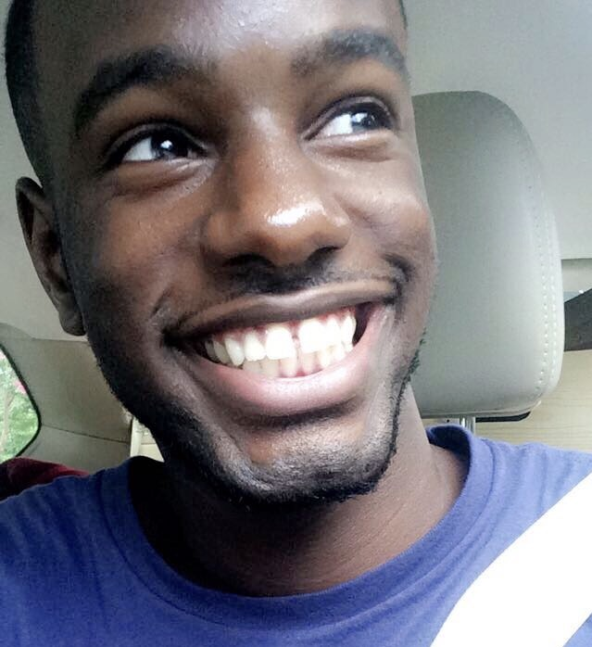
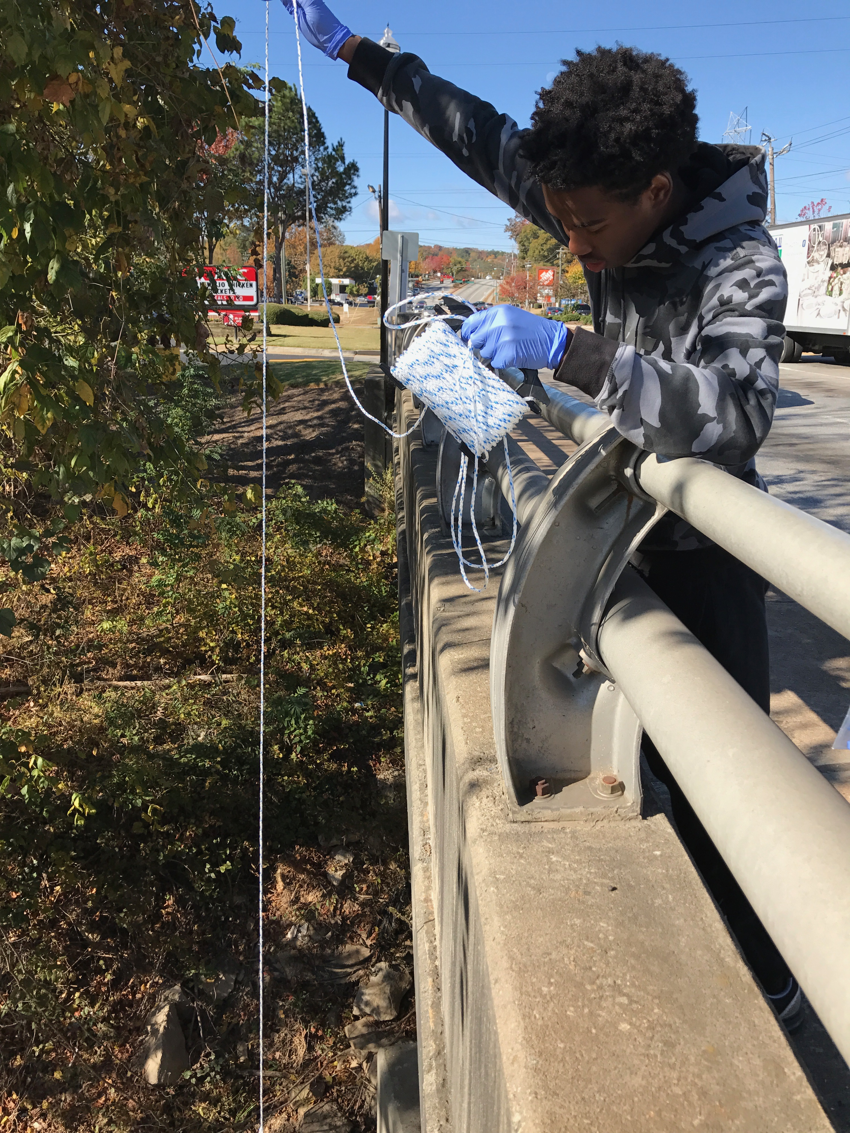
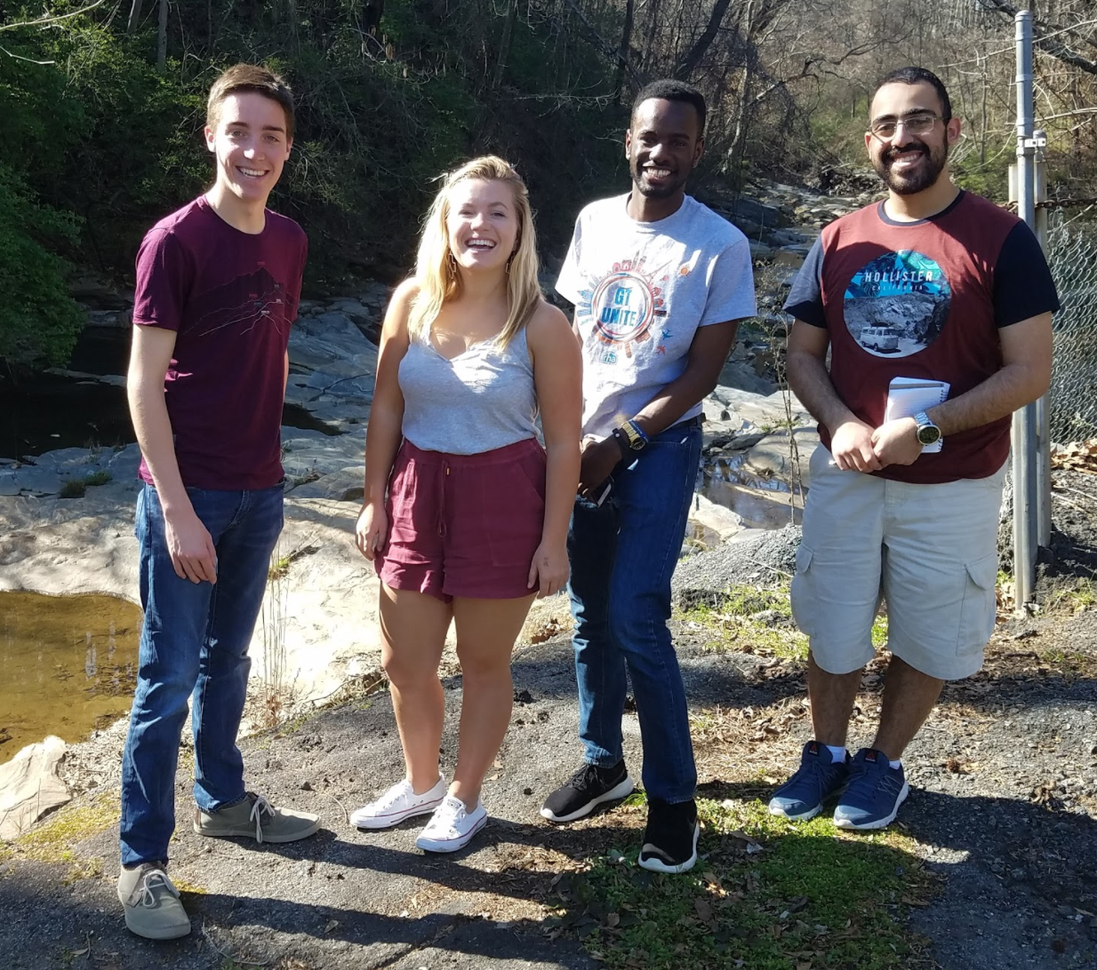
Student profile
John Butler III, CEE, 2021
“The SLS Program has not only allowed me to expand my understanding of the social equity, environmental, and economic intricacies that relate in order to create sustainable communities, but this program has also given me important connections and networking opportunities in the field of sustainability and social equity that my regular engineering education overlooks.”
River Rendezvous
FALL 2016: Takes SLS Foundation course “Technology & Sustainable Community Development,” sparking SLS interest; participates in many of Environmental Justice Series events
SPR 2017: Takes SLS-Affiliated course “Semester in the City;” joins Living Building Equity Petal Working Group; enrolls in Sustainable Cities Minor; joins UN RCE Youth Network
AY2018 and beyond: Plans to work with SLS as Student Assistant, pursue a sustainability internship with City of Atlanta, do an SLS-related research project, enroll in more SLS-Affiliated Courses, and continue involvement in Living Building
Career Interest: City Planning and Urban Design for Sustainable Cities
”Semester in the City”
Notes:
***

Slide 3
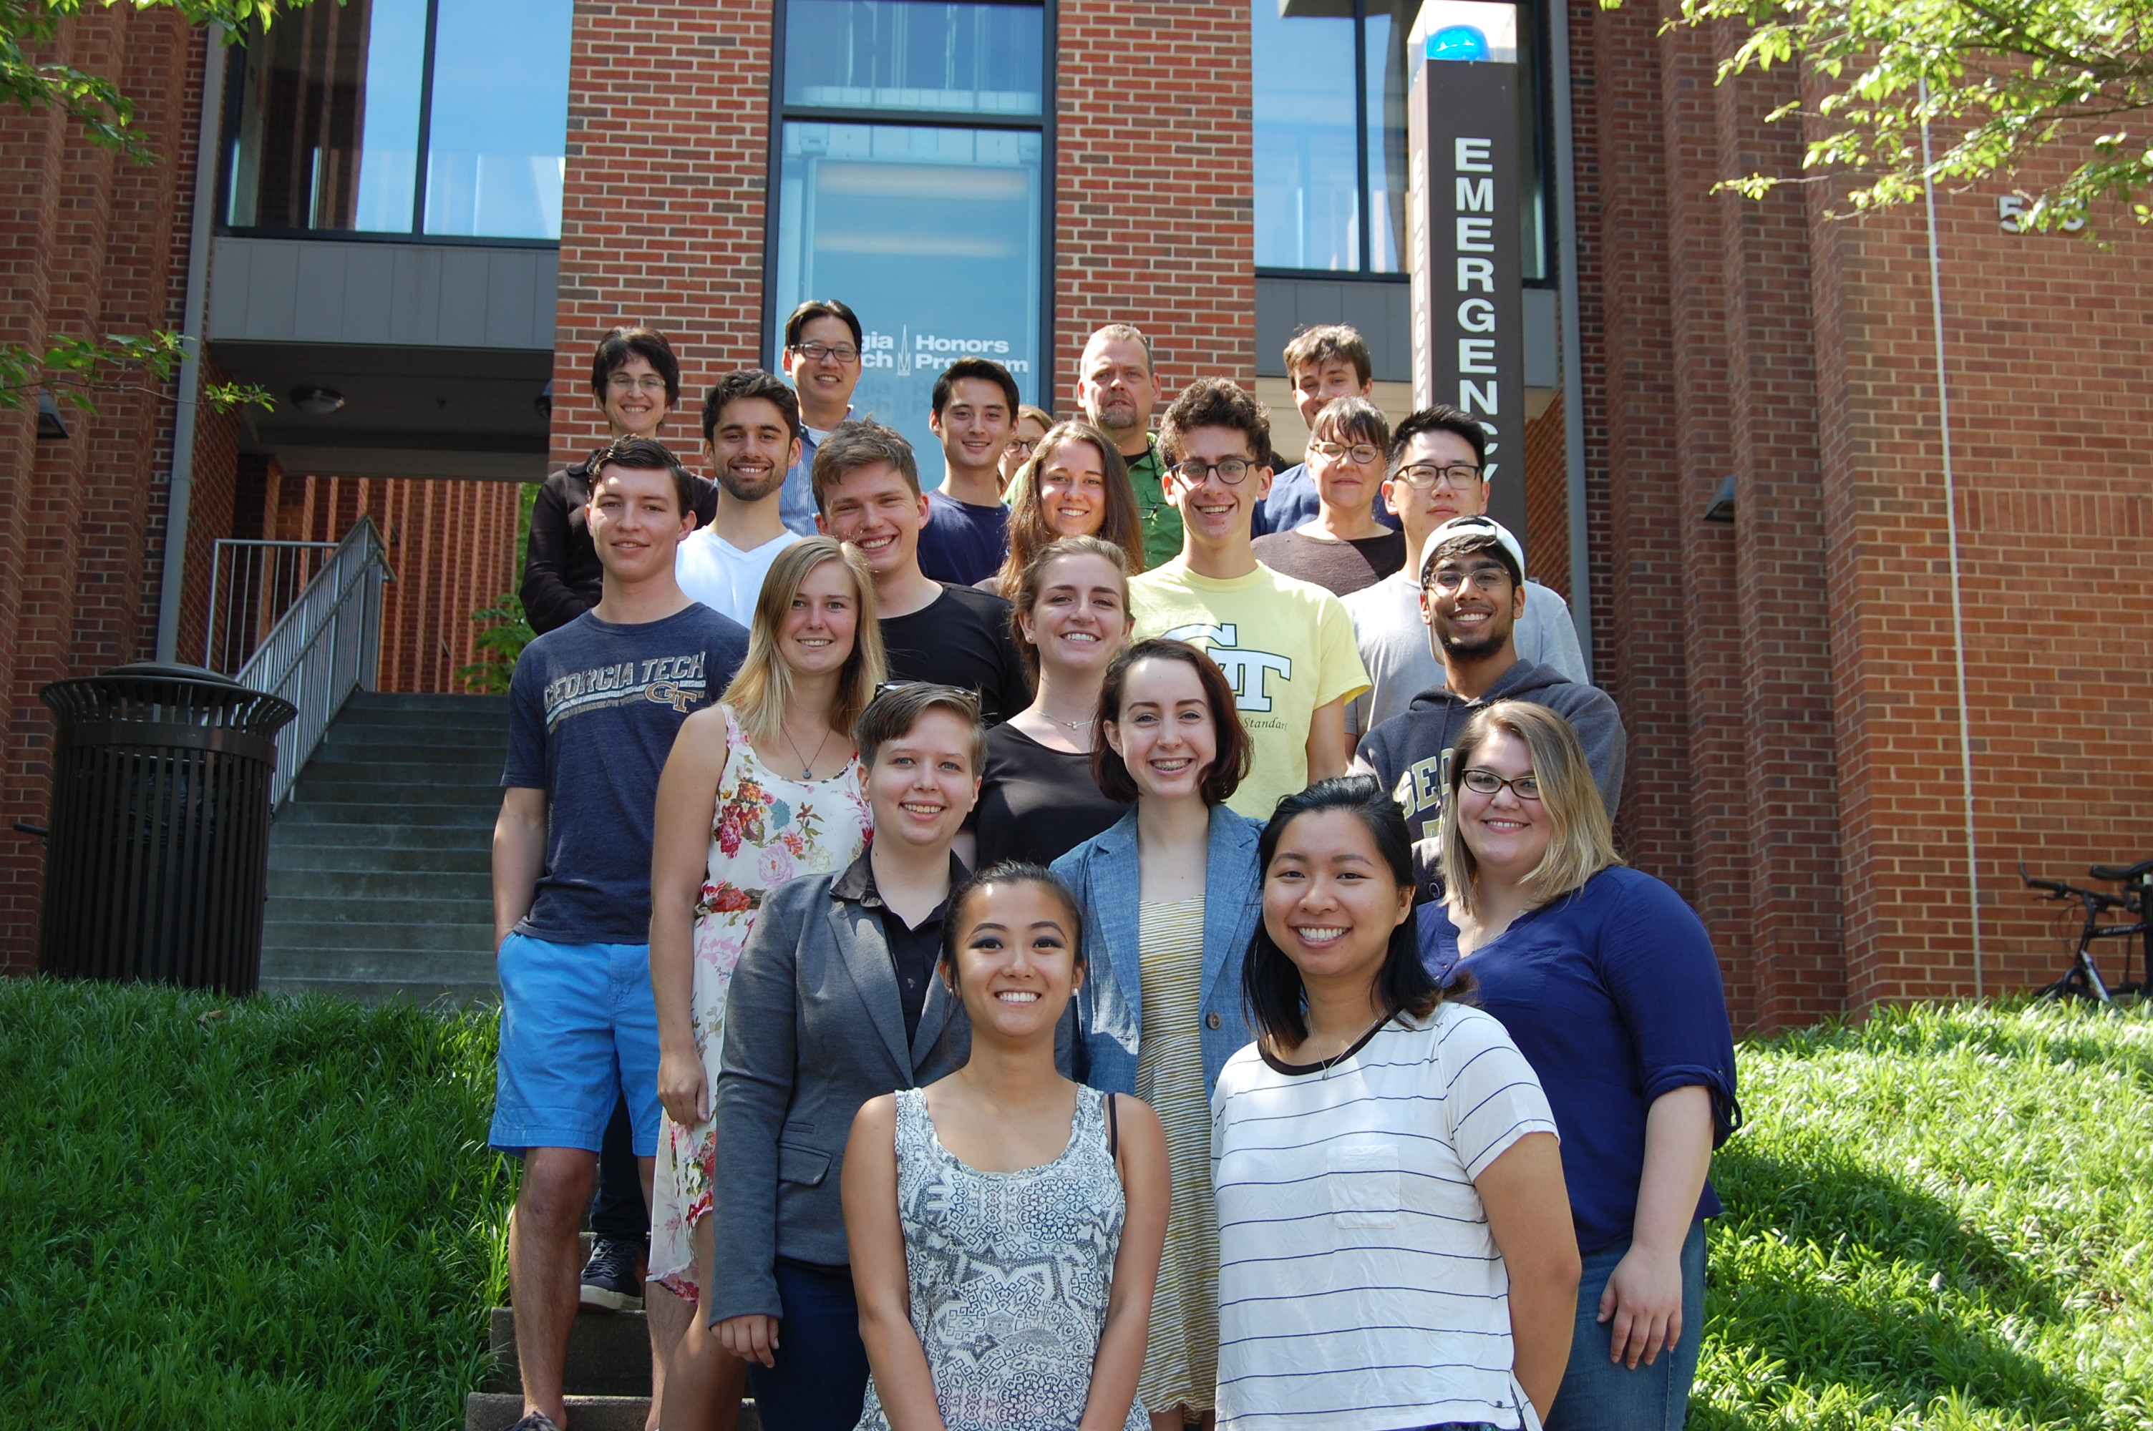
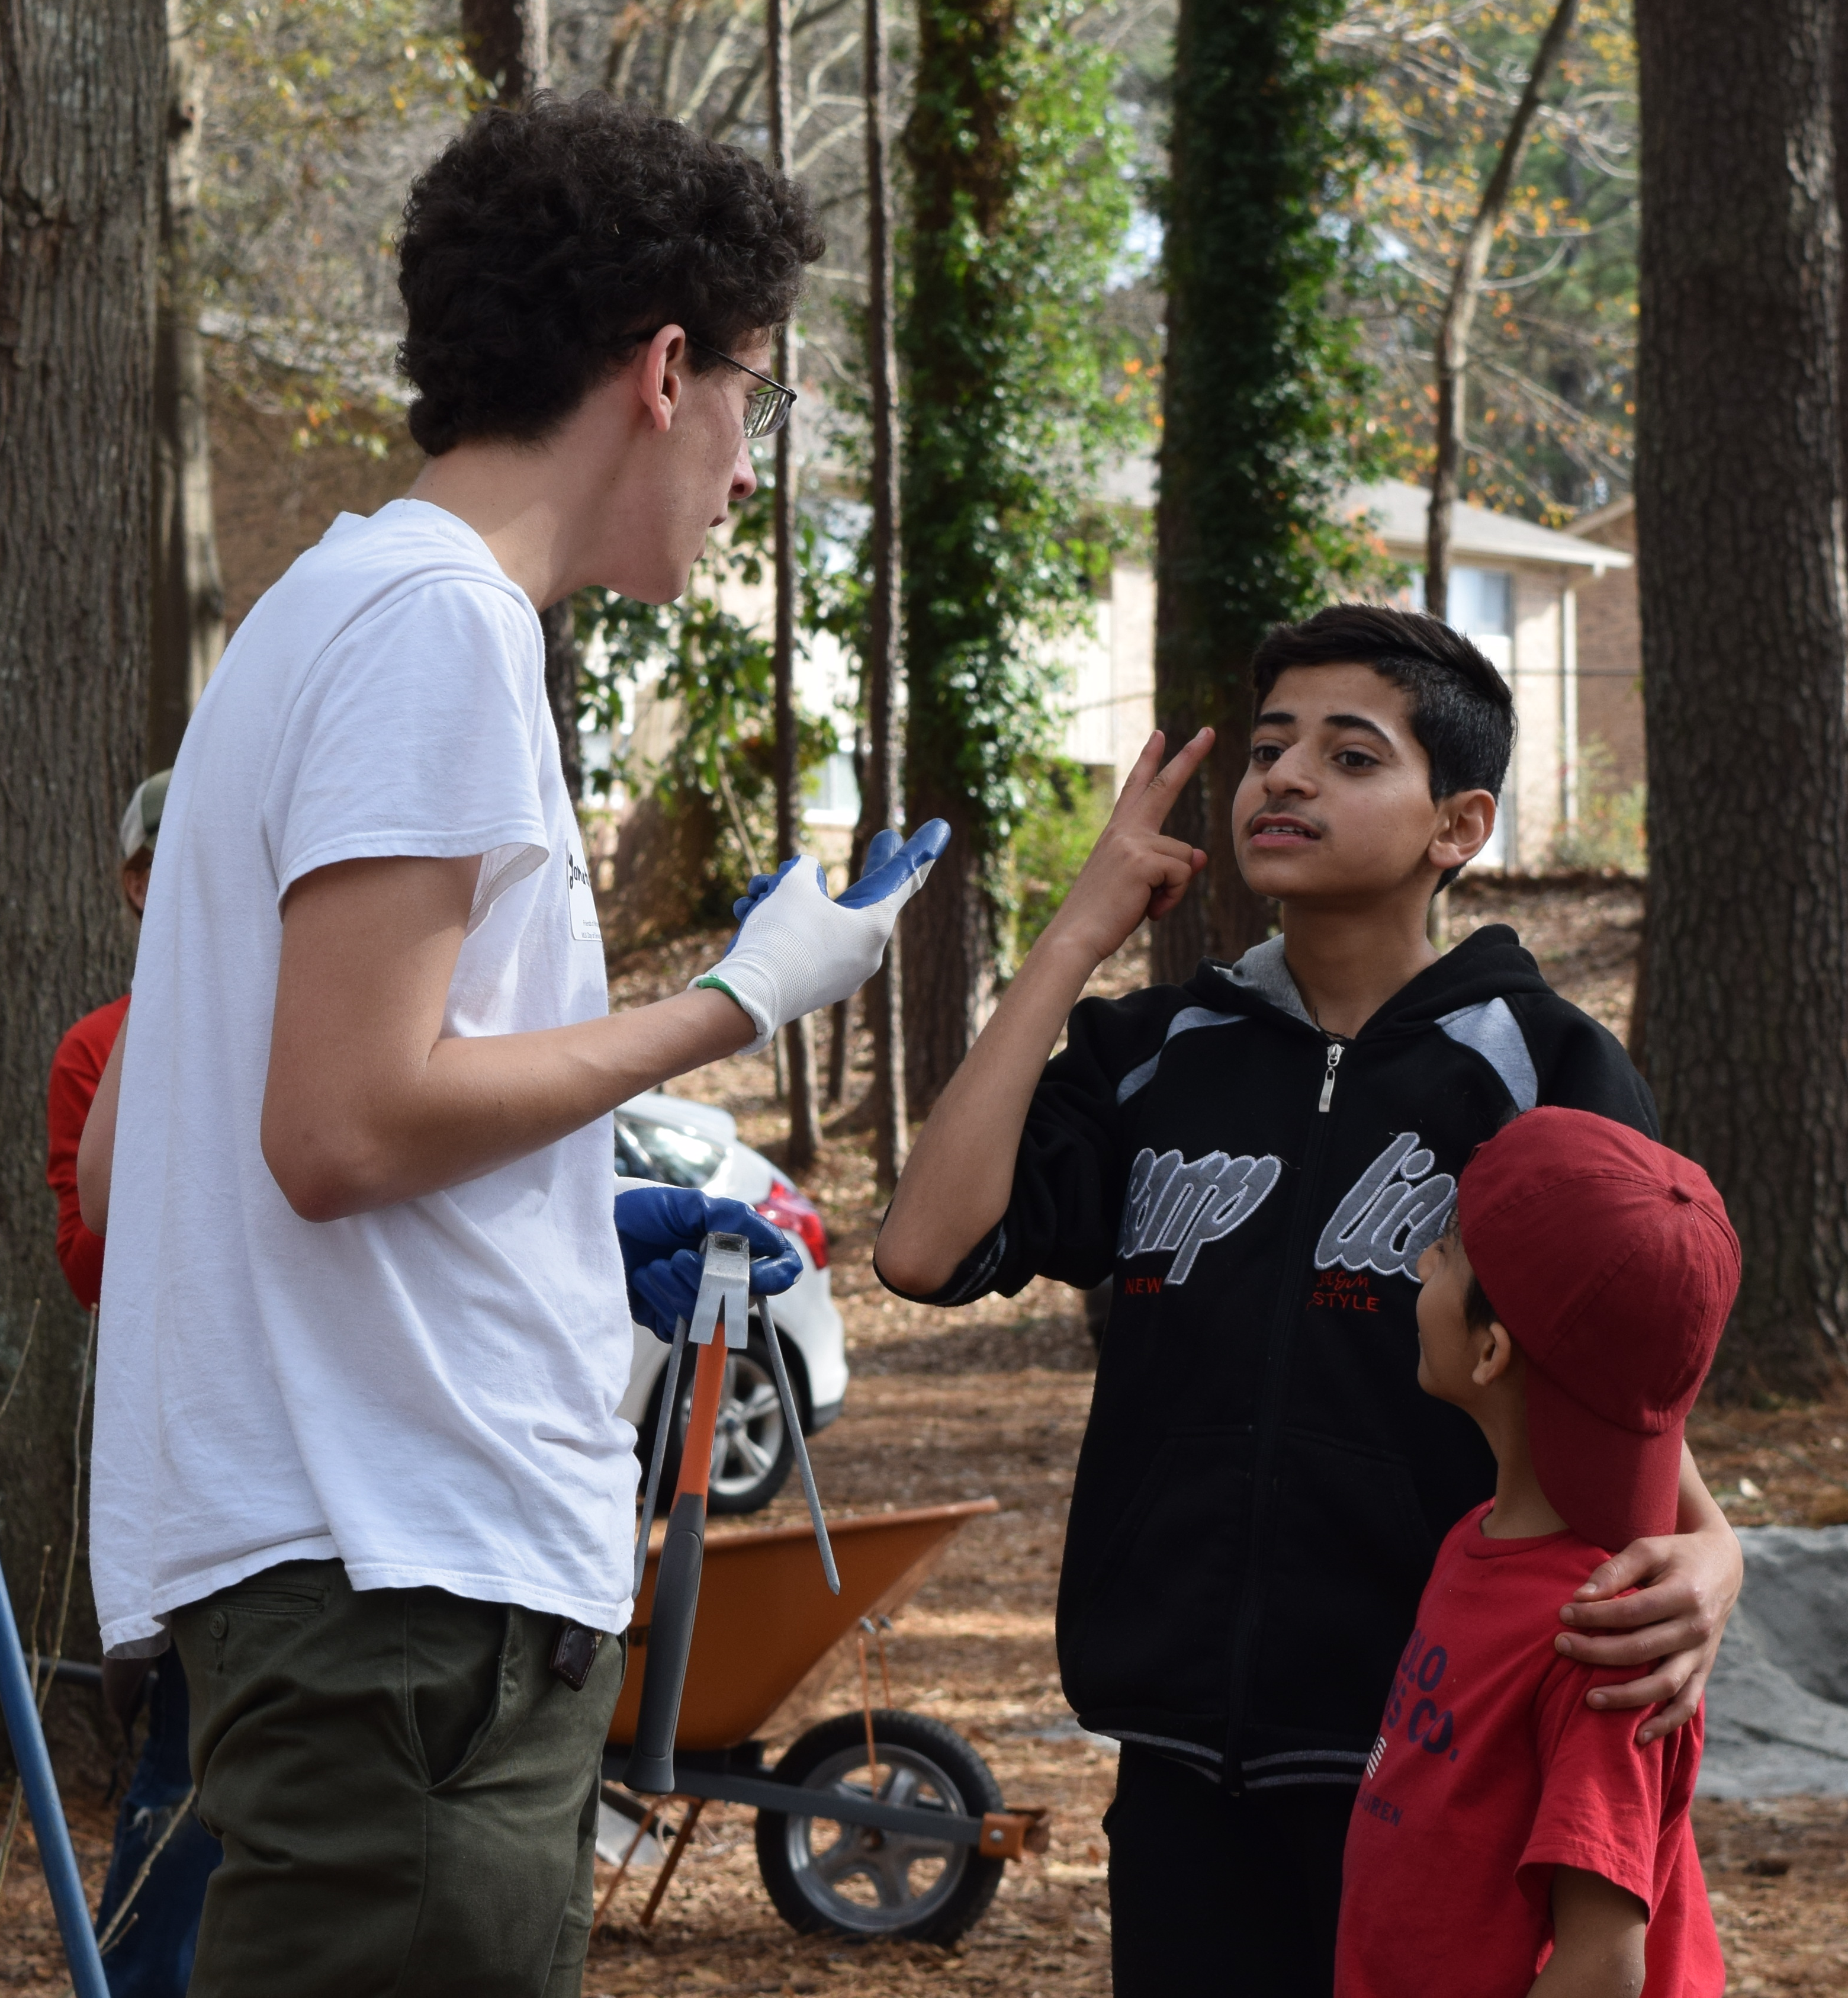
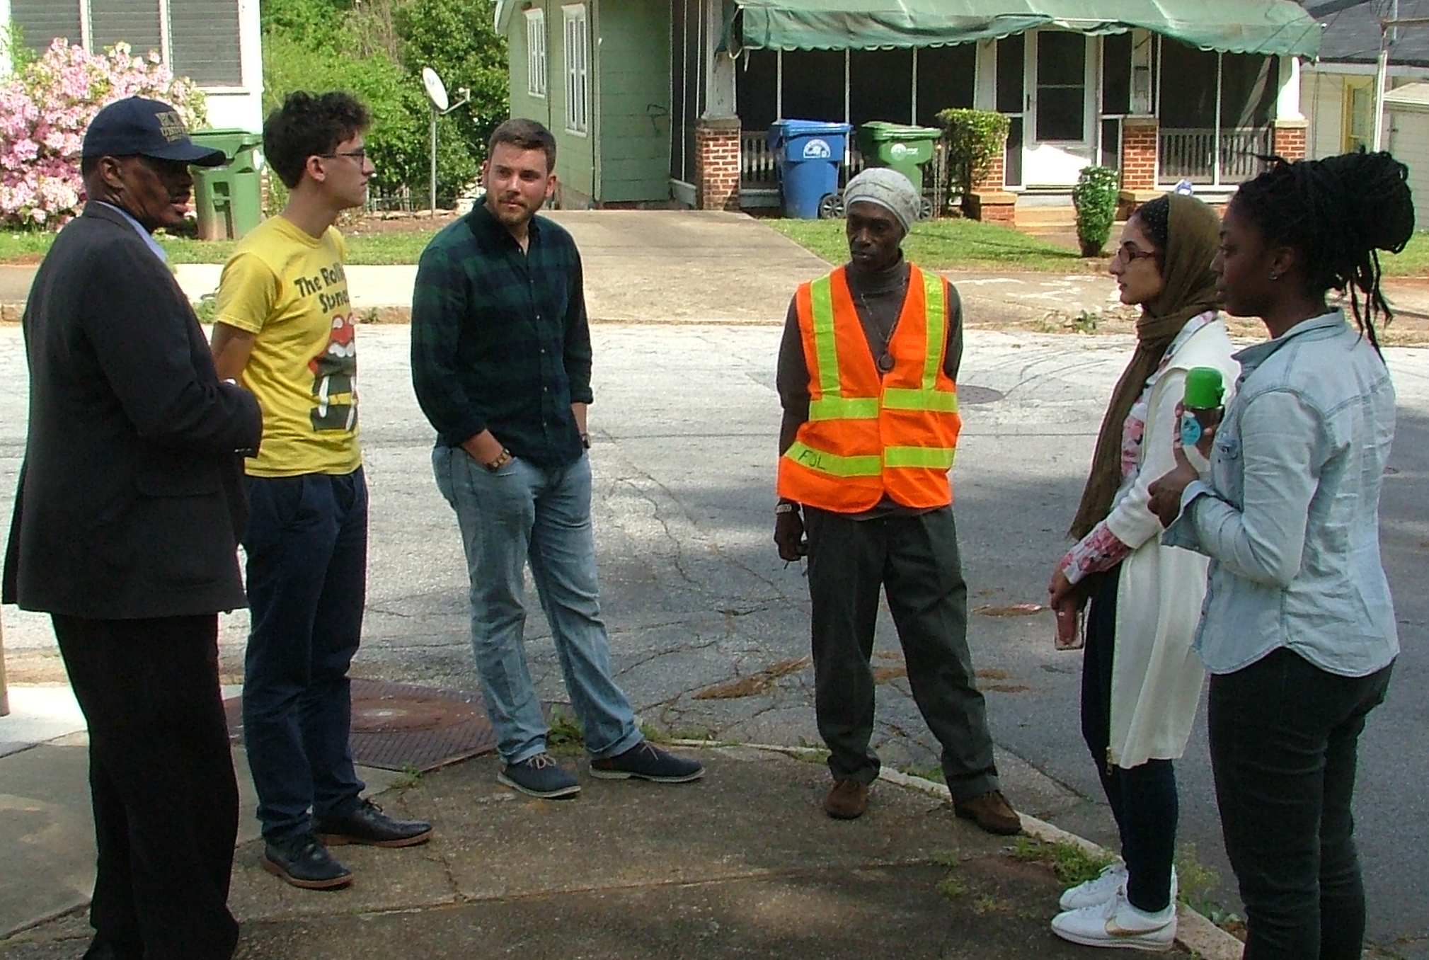
Student profile
Yonatan Weinberg, HTS, 2019
“I am grateful for the SLS infrastructure for giving me the opportunity to cultivate my interests in social sustainability. It has allowed me to learn about and actually work on what I am passionate about.”
Fall 2015: Hears about SLS HP courses through Grand Challenges
Spring 2016: Takes both foundation courses plus SLS-affiliated course, “Semester in the City;” attends SLS events & writes SLS blog post on Flint water crisis
Summer 2016: Starts working for SLS; participates in EngageATL
AY2017: Works for SLS, attends SLS events, works on Grand Challenges Westside oral history project (intends to apply for SLS funding); applies for Technology & Management program while pursuing Scheller Leadership Minor
Summer 2017: Participates in SLS-affiliated Leadership for Social Good Study Abroad in Eastern Europe (Scheller)
Career Interest: Consulting on corporate social responsibility
SLS Foundation Course
MLK Day in Clarkston
Semester in the City
Notes:
***

Slide 4
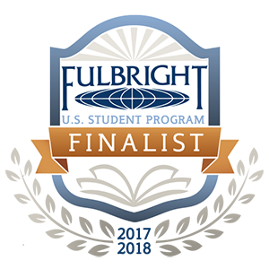
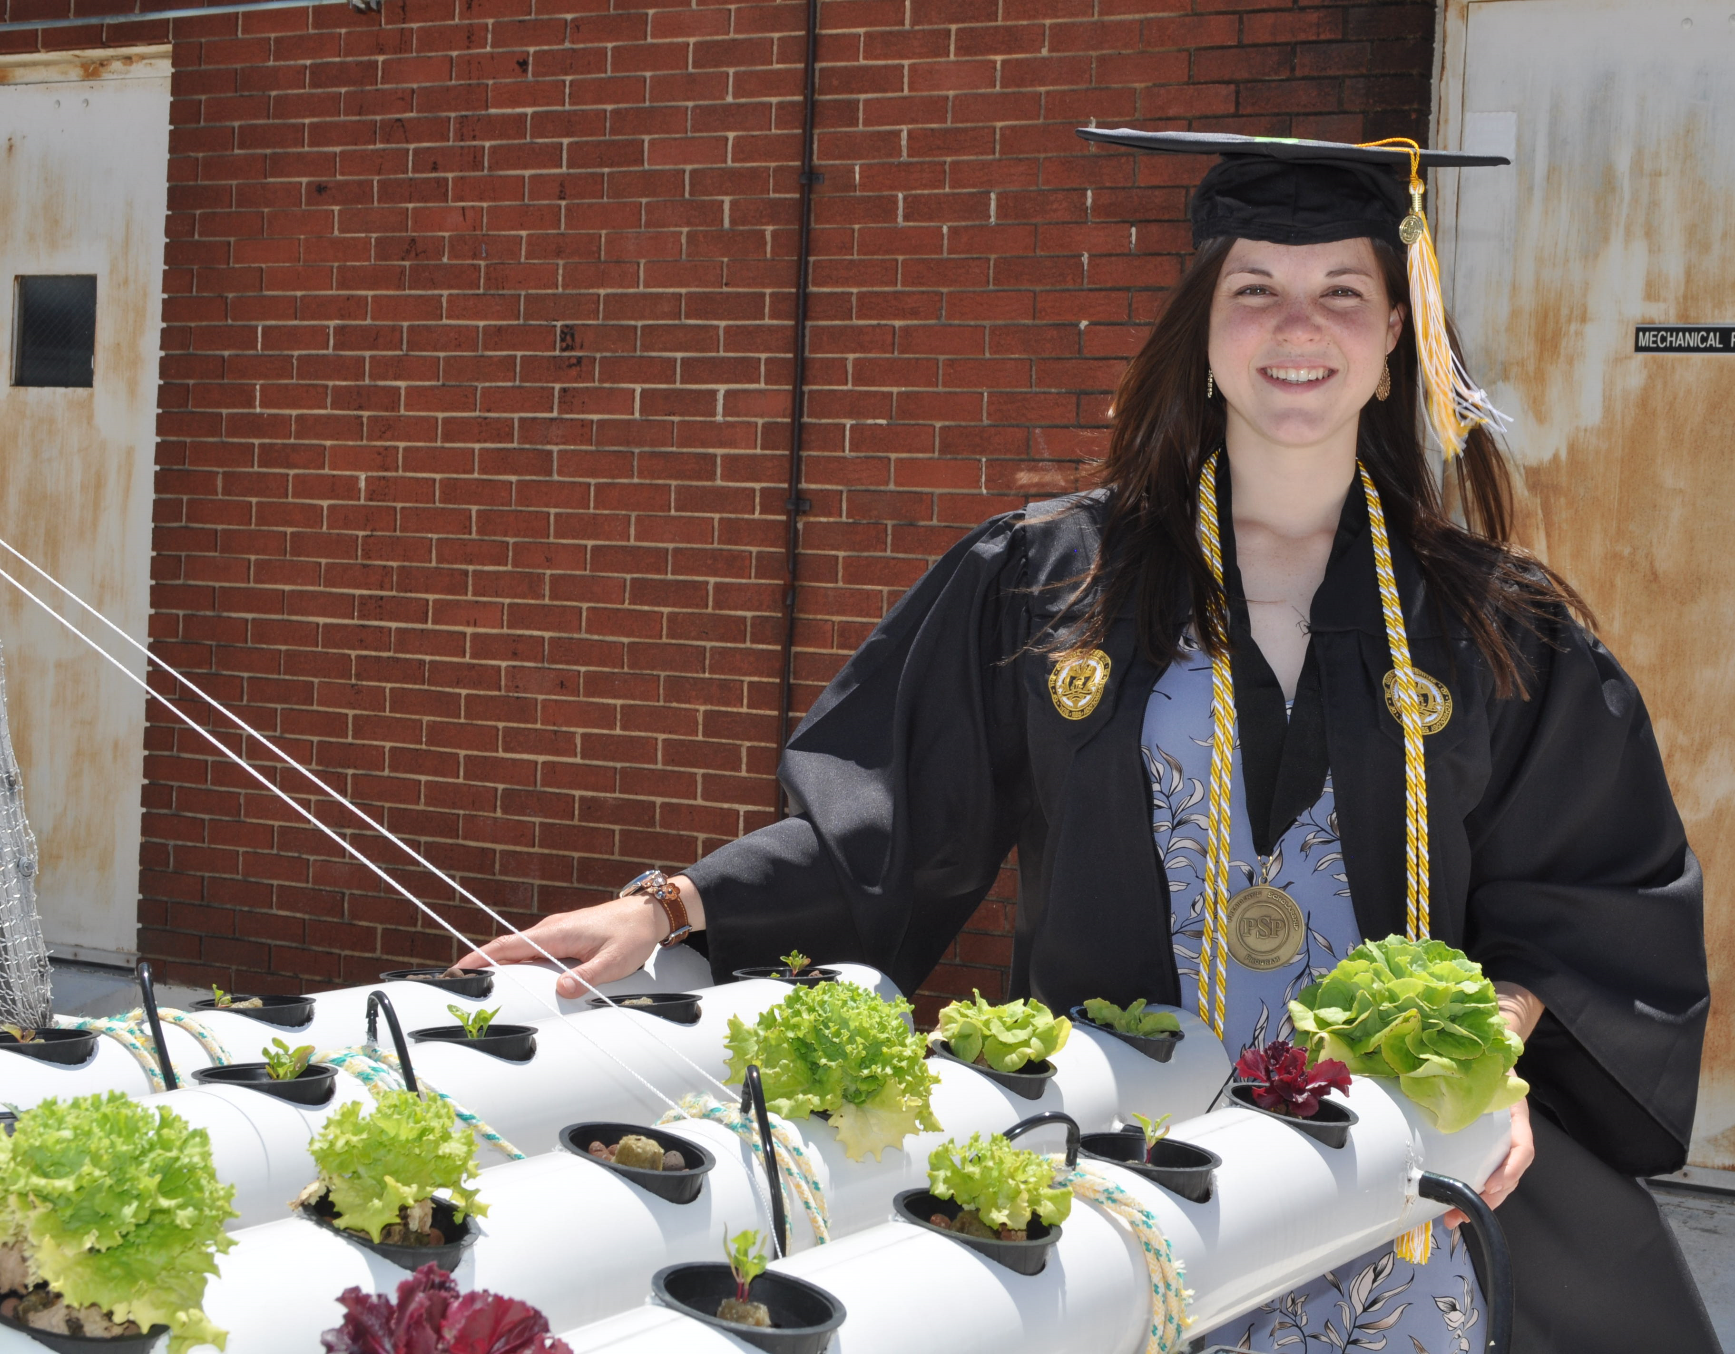
STUDENT PROFILE
“I have always been passionate about environmental sustainability, but through SLS, I have learned so much more about social sustainability and equity. I have been able to meet public officials, and this has greatly influenced how I approach problems systematically. I have expanded my network and realized what I'd like to do in my future career as a public leader in sustainability.
Through SLS, I was also able to start a new collaborative project with Friends of Refugees, leading a team of GT students to utilize their engineering skills by designing and building all the growing systems for their new educational greenhouse.
I am so grateful to SLS for helping to connect me with great projects and collaborations, and truly expand my network and knowledge surrounding sustainability.”
Nicole Kennard, MSE, 2017
Fall 2014: Provides input into QEP development
Fall 2015: Attends SLS Liam’s Legacy Symposium and becomes interested in public leadership as a career
Spring 2016: As President of Engineers for a Sustainable World, engages ESW in SLS’ Public Service Pathway program, receiving funding to develop urban farming project
Spring 2017: Begins working for SLS and attending more events, becoming more interested in sustainability careers; forges collaborative projects with SLS partners
Summer 2017: Continues to work at SLS, leads RCE Youth Network and continues to implement programs and projects at local urban farms
Fall-Summer 2018: Attends Newcastle University in the UK as a Fulbright Scholar, pursuing an MSc in Sustainable Agriculture and Food Security
Career Interest: Public or nonprofit work in sustainability focused on food systems and urban farming
Notes:
***

Slide 5
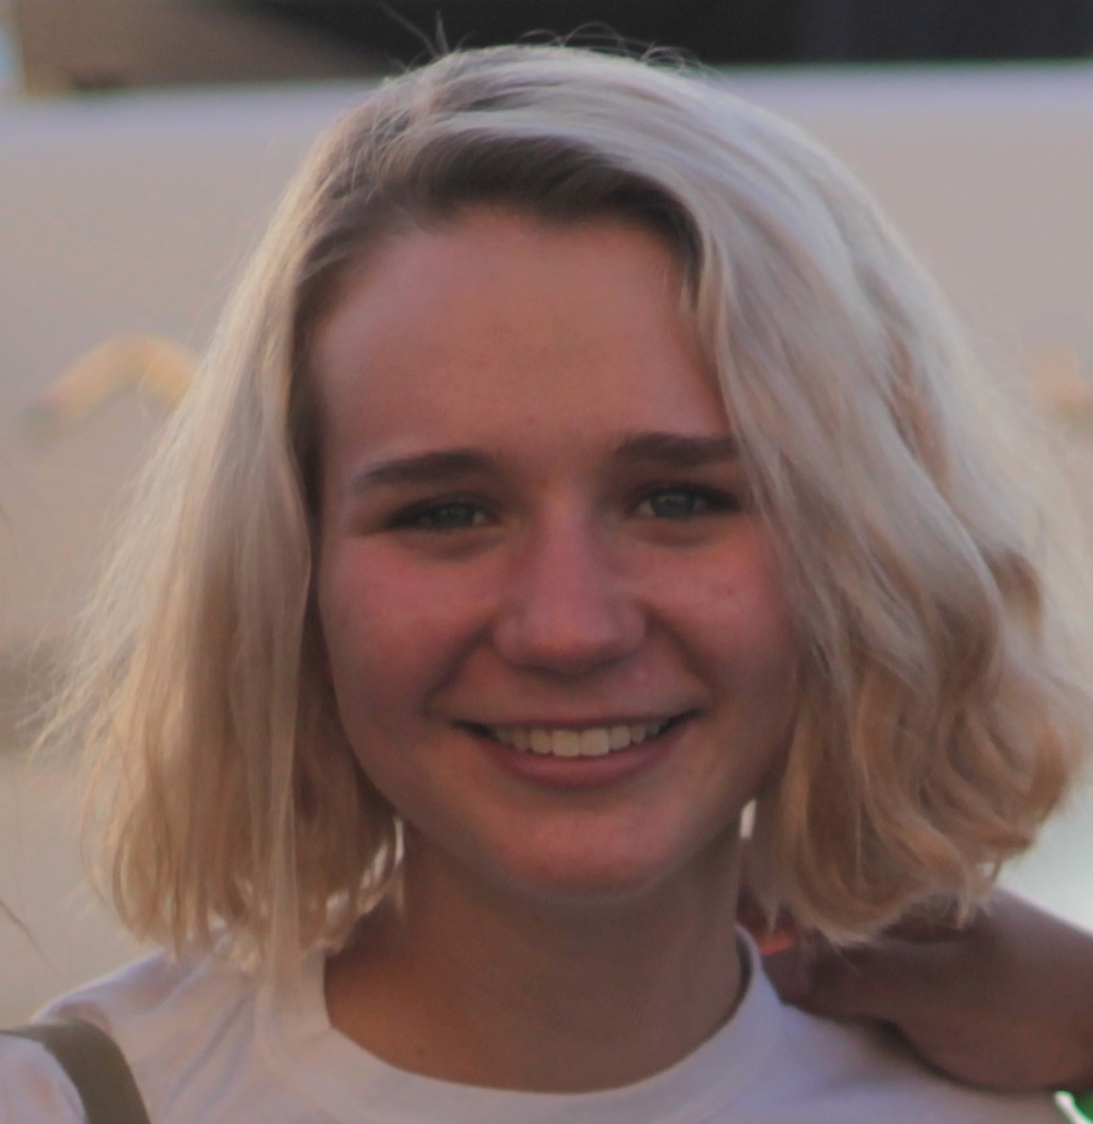
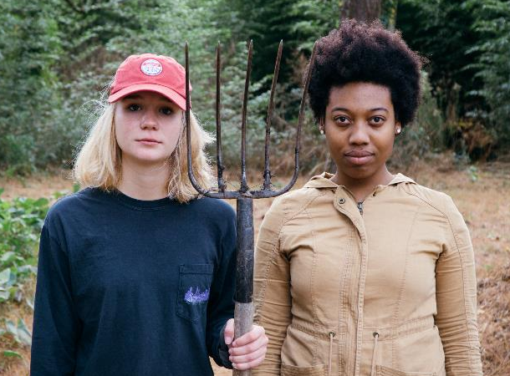
Student profile
Chloe Kiernicki, INTA, 2019​
"Before I started at Georgia Tech, my vague understanding of sustainability surrounded saving the ozone layer and reducing my carbon footprint. Through SLS, I have learned that these environmental burdens do not affect all people in the same manner, so cities must actively create a more equitable home for their citizens.”
Fall 2016: Attends Liam’s Legacy launch for the Environmental Justice Series, increases involvement in SLS-related activities​
Spring 2017: Travels to Washington, DC for MLK Civil Rights Tour with SLS, earns Commerce Club of Atlanta and SLS partnership grant to study local food sustainability and eating habits​
Summer 2017: Attends Measuring the Dream Symposium with SLS, participates in SLS-affiliated Japan Summer Program in Sustainable Development at Tokyo Institute of Technology​
AY2018 and beyond: Continues involvement in SLS events, expands participation in sustainability-related issues beyond Georgia Tech’s campus​
Career Interest: Designing a more equitable and sustainable Atlanta
American Gothic at Global Growers Work Day
Notes:
***

Slide 6
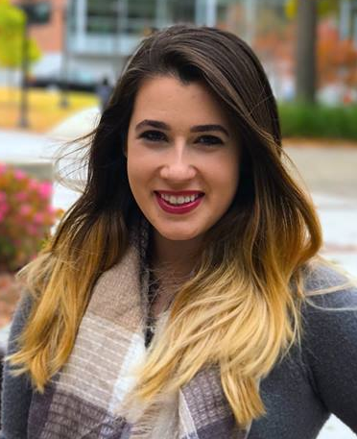
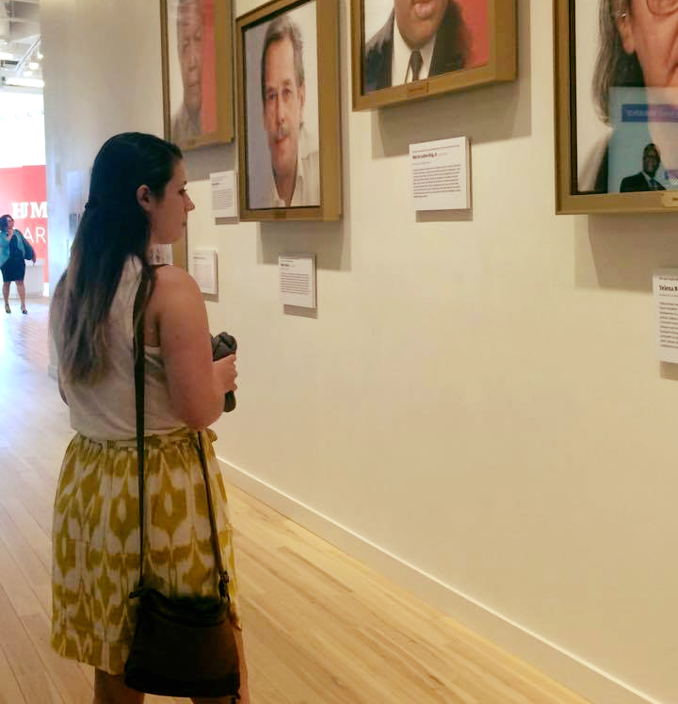
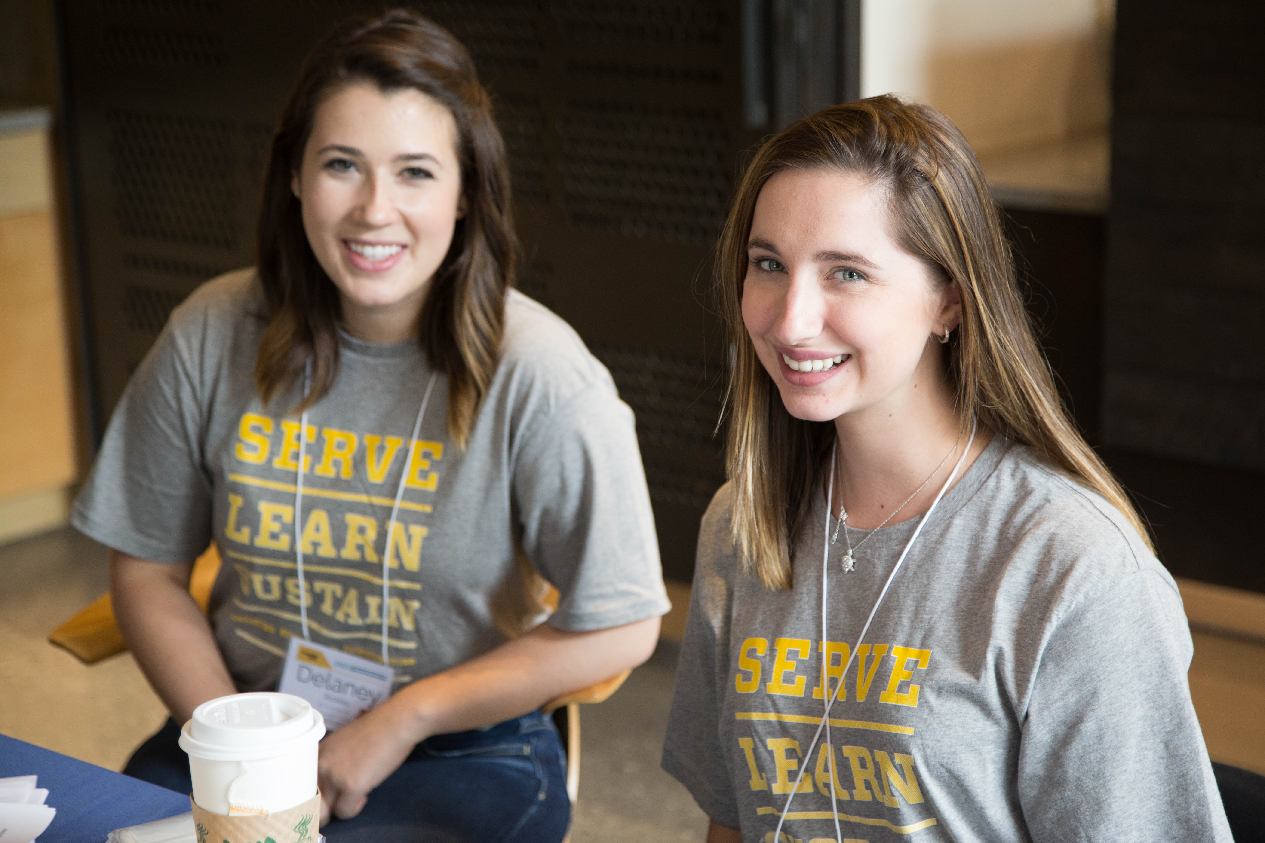
Student profile
Delaney Rickles, CEE, 2020
“I am so fortunate to have gotten involved with SLS early in my college career! The program has made me an all-around more aware and thoughtful person in addition to influencing my decision to pursue a career in designing equitable and sustainable communities.”
Fall 2016: Learns about SLS during Freshmen Orientation and participates in SLS Foundation Course, “Technology and Sustainable Communities” as a result
Spring 2017: Switches major to CEE to focus more on sustainable cities; elected to executive board of Enterprise to Empower as Marketing Chair
Summer 2017: Begins working with SLS as a student assistant, attends “Measuring the Dream” symposium
AY18 and beyond: Continues to work with SLS and pursues minor in Sustainable Cities
Career Interest: Using a background in civil engineering to design more equitable and productive public space in Atlanta
Measuring the Dream Symposium
INSS: “Smart Cities” Conference
Notes:
***

Slide 7
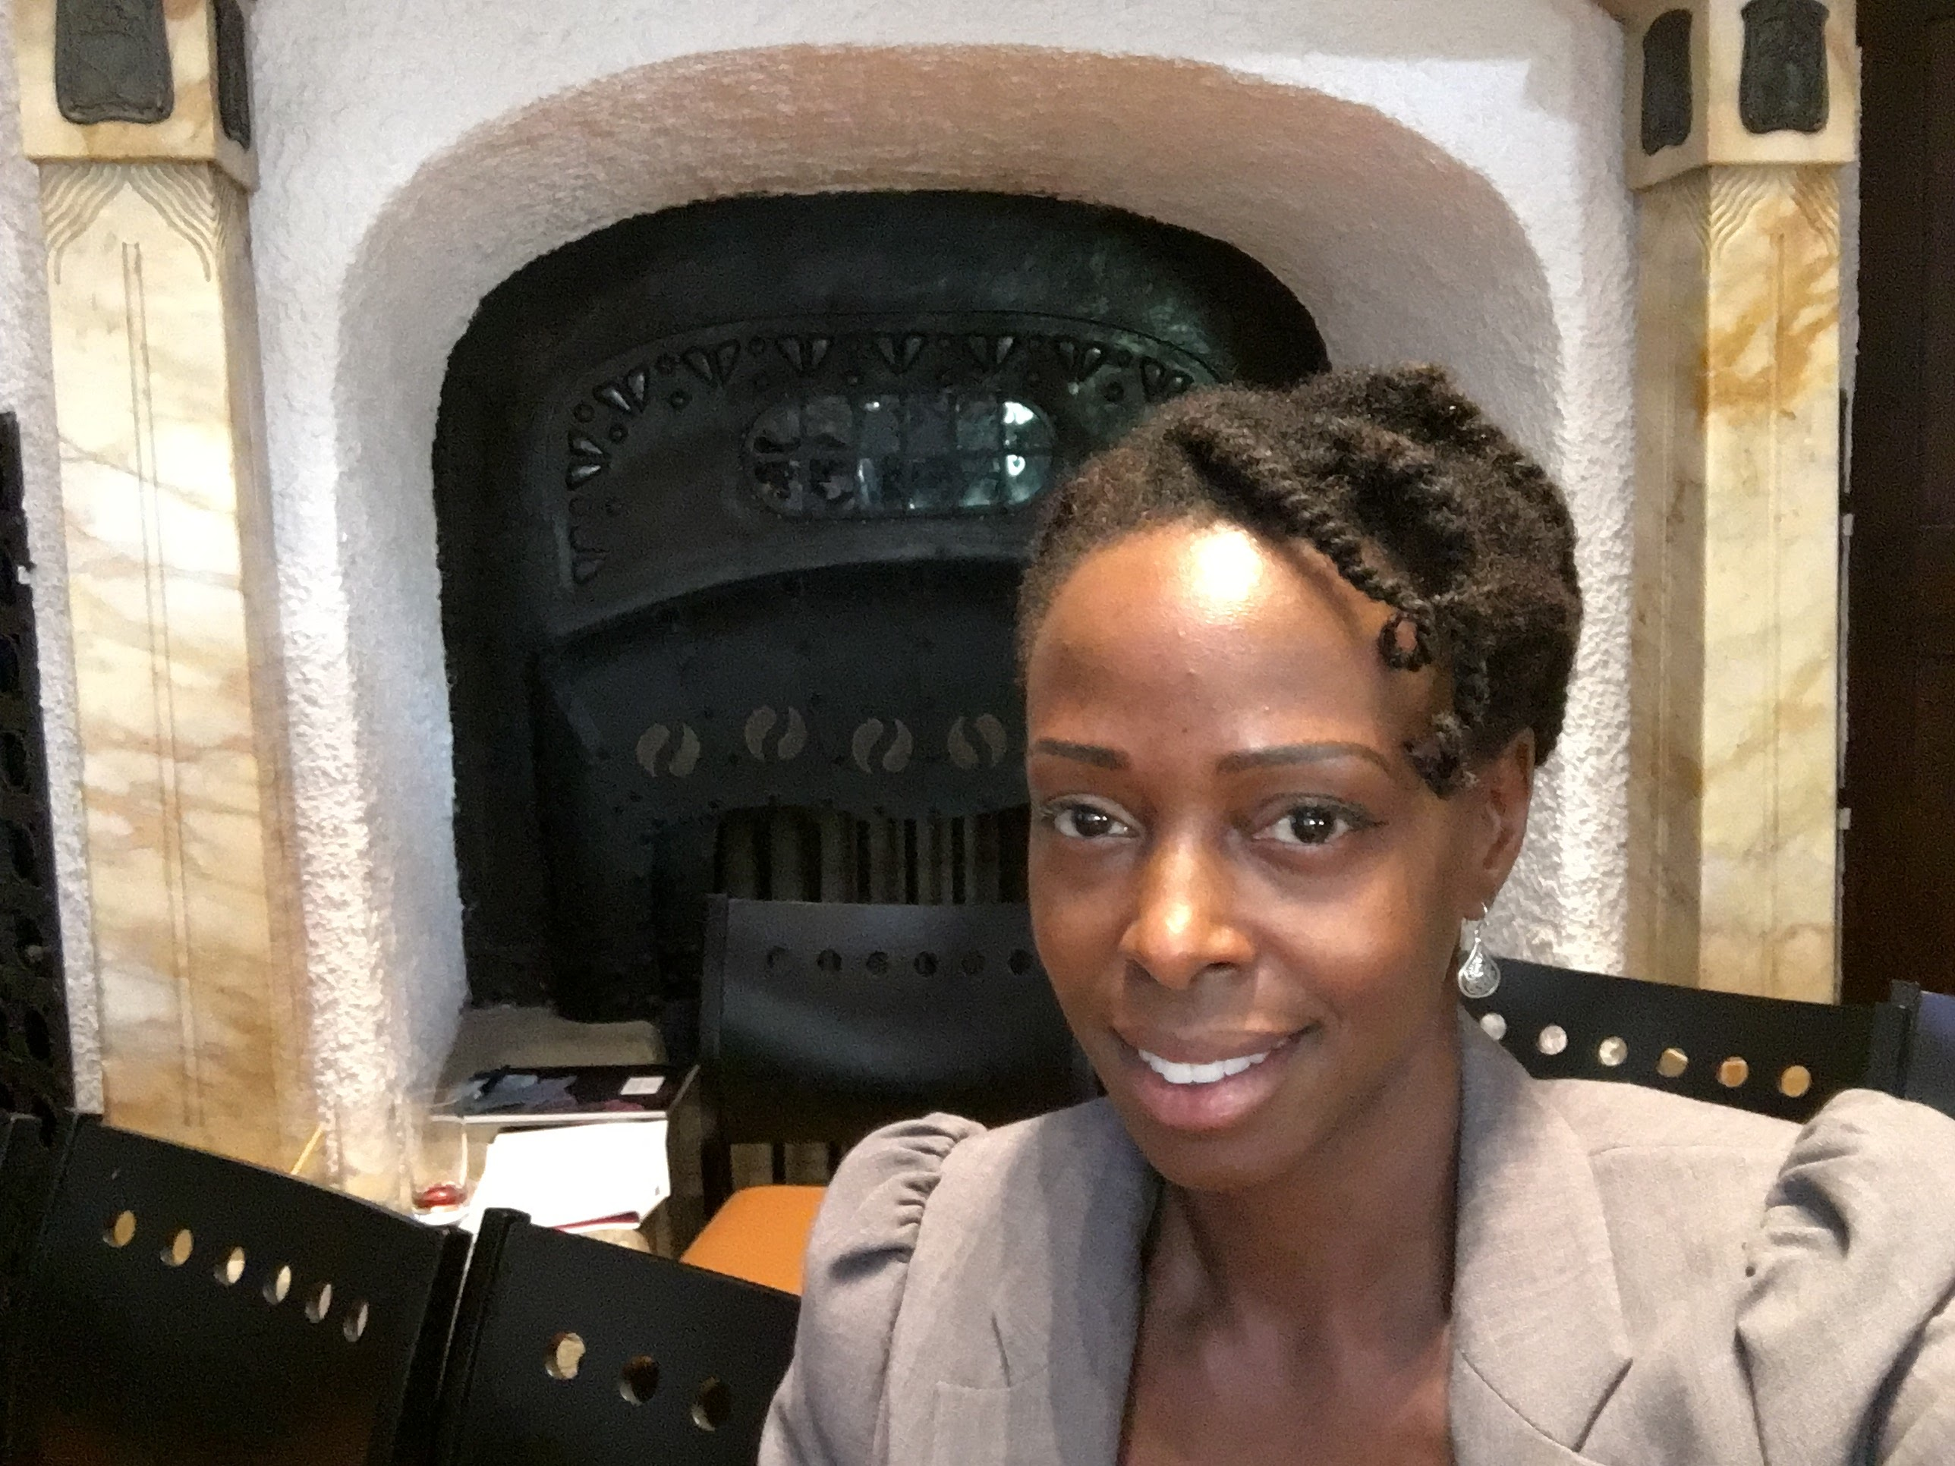
Student profile
Dionne Nickerson, PhD Marketing, 2019
“I am grateful for the support provided through SLS for my very first course at Georgia Tech! Since I am building this course from the ground up, the SLS support has been instrumental. I have already been able to network with scholars from around the world on how to effectively integrate sustainability into more traditional disciplines.”
Fall 2016: Submits proposal for SLS course development funding pertaining to the SLS theme of “creating sustainable communities.”
Spring 2017: Is awarded funding and begins developing “Sustainable Marketing” undergraduate course.
Summer 2017: Continues developing “Sustainable Marketing” course, receives SLS course affiliation, presents research at the International Symposium on Sustainable Fashion Consumption.
AY2018 and beyond: Teaches “Sustainable Marketing” course and continues research investigating the impact of sustainability on marketing outcomes
Career Interest: Influencing the next generation of business leaders through sustainability-focused courses and empirical research
Symposium on Sustainable Fashion Consumption
Notes:
***

Slide 8
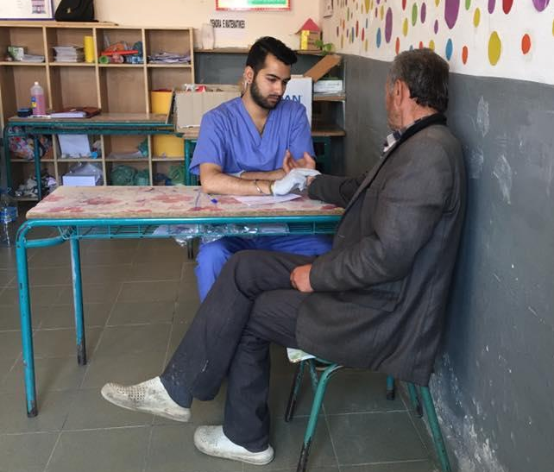
STUDENT PROFILE
Arush Lal, BSBA, 2017
“SLS is an incredible initiative that mobilizes our campus community to explore how to engage on international issues, providing a pathway to becoming true global citizens that are dedicated and driven to developing solutions for a better tomorrow.”
Fall 2014: Founded on-campus chapter of Volunteers Around the World, committed to providing critical health care to international communities in a sustainable way
Spring 2014: Began proposing a project based on the QEP -- a new undergraduate major in Global Health Systems and Technology
Spring 2017: Joined SLS Advisory Board, with the chance to engage with peers on UN RCE application and meet like-minded students
Summer 2017: Joined Global Health Corps as a Global Policy Associate with IntraHealth International, supporting health workforce development around the world
Career Interest: Global health security and universal health coverage
Notes:
***

Slide 9
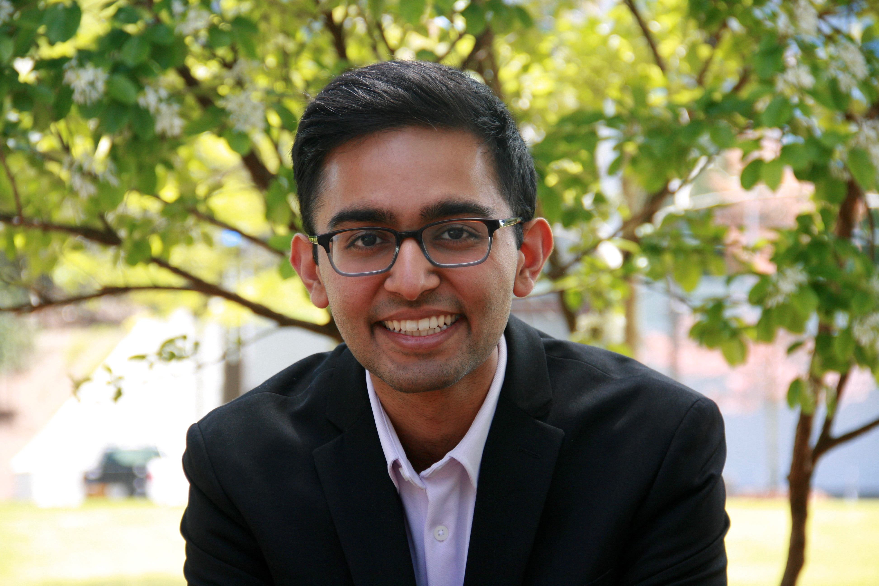
Student profile
Suraj Sehgal, Marketing, 2018
“To me, sustainability has always been a vague concept. Today, it has become an ideal that communities are often striving for. Through Serve-Learn-Sustain, I have had the opportunity to explore the multiple aspects of sustainable communities, including the equal importance of economy, environment, and equity.”
Winter 2015: Attended the GREEN program Renewable Energy and Sustainability Study Abroad Program in Iceland
Spring 2016: Took the SLS Sustainable Community Principles Course
Fall 2016: Attended the First Annual Just Energy Summit in Atlanta
AY 2018 and beyond: Continue to attend SLS events, president of Epic Intentions, a student organization that does consulting for non-profit organizations
Career Interest: Researching in technology and global development

Slide 10
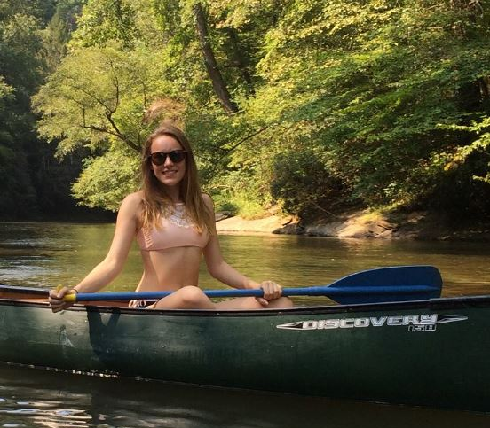
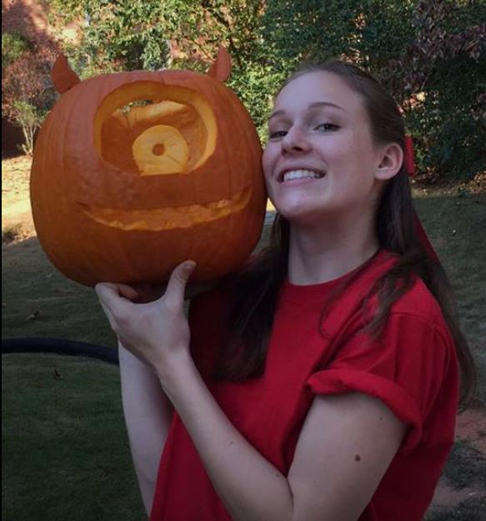
Student profile
Student profile
Heather Mikan, CS, 2021
Suraj Sehgal, Marketing, 2018
“I’ve always considered environmental/economic sustainability the greatest concern to life on earth. Creating efficient and sustainable communities is important for the health of our planet and the health of the human race. For this reason, I have always been passionate about sustainability and was thrilled for the opportunity to work with SLS”
“To me, sustainability has always been a vague concept. Today, it has become an ideal that communities are often striving for. Through Serve-Learn-Sustain, I have had the opportunity to explore the multiple aspects of sustainable communities, including the equal importance of economy, environment, and equity.”
Winter 2015: Attended the GREEN program Renewable Energy and Sustainability Study Abroad Program in Iceland
Spring 2016: Took the SLS Sustainable Community Principles Course
Fall 2016: Attended the First Annual Just Energy Summit in Atlanta
AY 2018 and beyond: Continue to attend SLS events, president of Epic Intentions, a student organization that does consulting for non-profit organizations
Career Interest: Researching in technology and global development
Summer 2016: Participated in Georgia Tech’s PUSH (Perusing Urban Sustainability at Home) camp
Fall 2016: Writes common app paper about ways to fix food deserts/improve public transpiration in Atlanta
Fall 2017: Perseus degree in Industrial Engineering with a passion for developing inefficient/unsustainable communities
Summer 2018: Switched from Industrial Engineering to Computer Science
Spring 2018: Began working with SLS as a student assistant, considers applying for sustainability related minor/concentration
Career Interests: Using my major and knowledge of efficiency and sustainability to develop cities like Atlanta

Slide 11
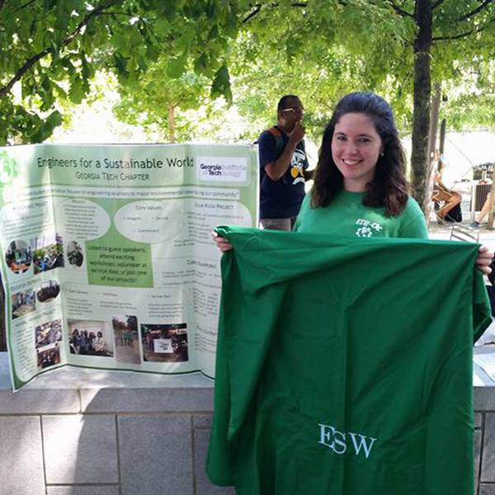
Student profile
Jamie Curtis, MSE, 2018
“I’ve been interested in sustainability since high school and am so fortunate to have had the opportunity with SLS to be one of the students shaping sustainability and sustainability education at Georgia Tech.”
Fall 2014: Gets involved in sustainability through Engineers for a Sustainable World’s Hydroponics Project, later affiliated with SLS
Spring 2015: Attends SLS kickoff event
Summer 2015: Attends GREEN Program Renewable Energy and Sustainability Study Abroad Program in Iceland
Fall 2016: Takes PUBP 3600, a SLS-affiliated course; joins ESW’s executive board as Treasurer
Spring 2017: Takes CP 2233, a SLS foundation course
Fall 2017: Starts working as a SLS student assistant; becomes ESW’s President
AY 2018: Continuing working on events for ESW and SLS, including ESW National Conference
Career Interests: Working in R&D and pursuing community urban agriculture and historic preservation

Slide 12
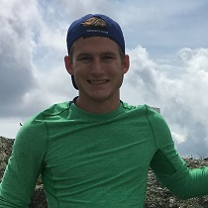
Student profile
Brendan O’Brien, ME, 2020
“I love trying to better the world we live in, and being a part of a department that does this at one of the greatest universities is beyond awesome. I'm excited to begin working with SLS!”
Spring 2017: Gets involved in ATL UN RCE, begins web development for Engineers Without Borders
Fall 2017: Starts working as a web developer for SLS
AY 2018 – AY2020: Continuing working SLS
Summer 2020: SLS Internship Program
Career Interests: Engineering at a company with a positive world impact in aerospace; Entrepreneurship

Slide 13
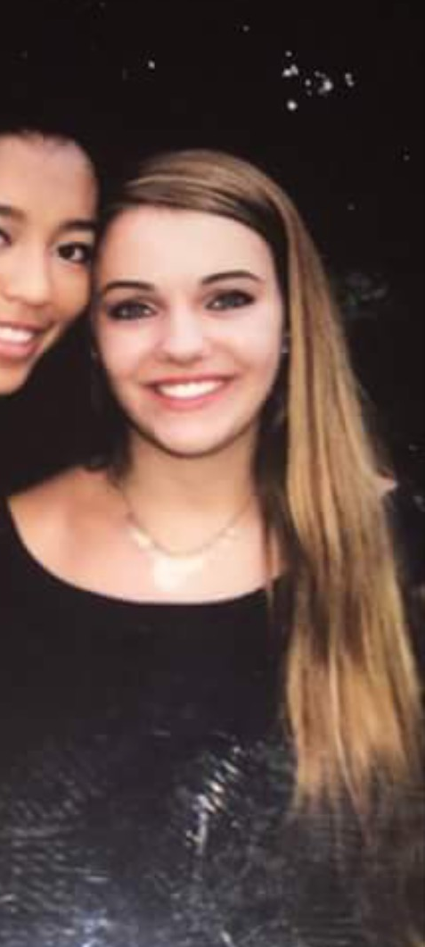
Student profile
Caroline Tanzy, BME, 2020
“I believe sustainability is vital to every academic field. I believe that college students should be educated to think about the future of society not only in terms of advancing technology but also in terms of taking care of the world around them.”
Fall 2016: Took GT 1000 class with Ms. Chatfield as an instructor; peaked interest in sustainability and sustainable building design
Summer 2017: Worked in cellular physics lab and suggested ways to dispose of chemicals in a more environment-friendly way
Fall 2017: Started working at the sustainability office in the CULC; very excited to start on sustainability projects and to help streamline events
Career aspirations: Currently, I hope to continue working in my lab and start the PETIT scholar program in the spring. I’m minoring in CS and getting a certificate in marketing. Once I graduate, I will get my MBA and then go into prosthetic/artificial heart valve design and marketing.

Slide 14
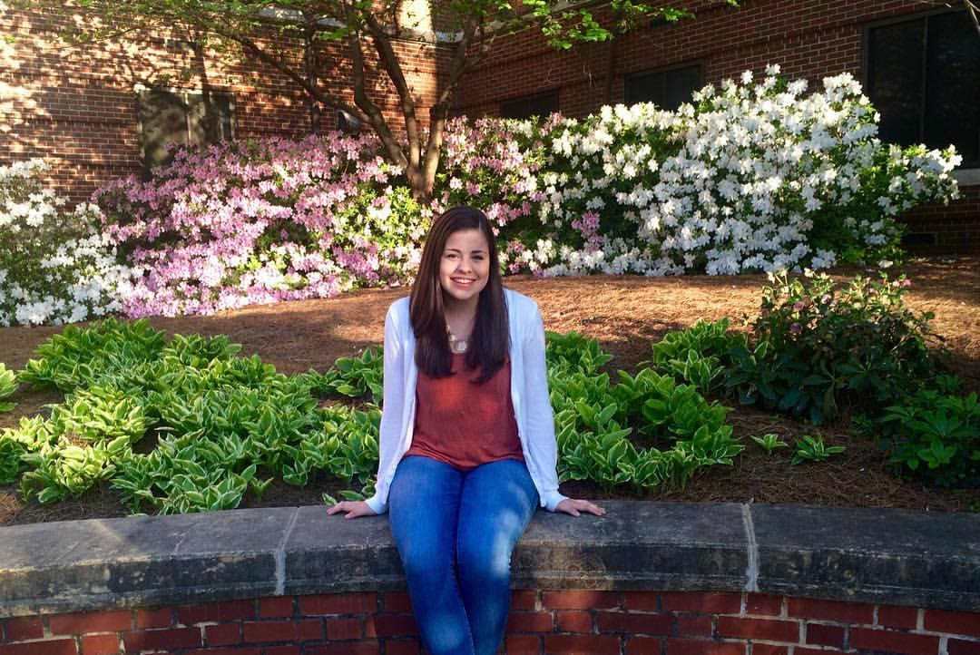
Student profile
Michelle Henriques, CEE, 2019
“Being involved with Serve-Learn-Sustain since the beginning of my Georgia Tech experience has been a blessing. Academically it has opened my eyes to the direction I want to take
Fall 2015: English 1101 “Art of Advertising” Course: Service learning course where my group worked with the Center for Serve-Learn-Sustain to create a marketing strategy
Spring 2016: took SLS foundation course GT 2803 “Introduction to Sustainable Systems
and Communities” and SLS affiliated English 1102 “Ecomedia”
February 2016: Began working at SLS as student assistant; developed SLS social media and newsletter strategy
October 2017: Attended AASHE conference with SLS as co-presenter
Spring 2018: take SLS Study Abroad course “Sustainable Transportation Abroad” as well as EAS 2640 “Environmental Measures”
AY2018 and Beyond: continue working to build SLS on campus and personally get more deeply involved with a sustainability related project or research on campus
Career Interest: Incorporate my love for transportation systems, cities, and sustainability
my civil engineering degree in. Beyond my studies – learning about, promoting, and being involved in all the different sustainability initiatives on campus from courses to projects to events gives me so much pride in the direction Georgia Tech is going and further motivates me to keep building the campus sustainability community.”
Notes:
***

Slide 15
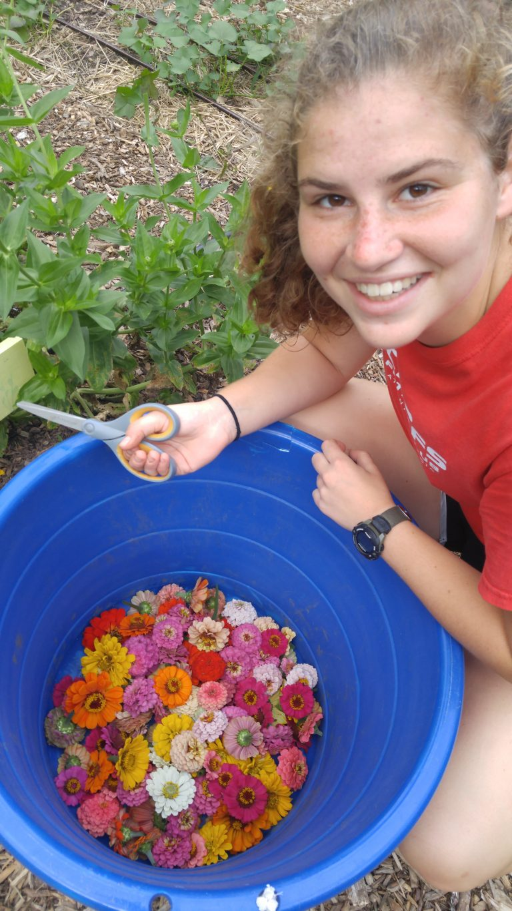
Student profile
Mira Kaufman, PUBP, 2021
“SLS allows me to directly engage in issues that interest me. I appreciate how SLS provides unique, hands on opportunities to connect with my community and apply the skills I learn in my coursework to real life”
Summer 2017: Participates in EngageATL
Fall 2017: Becomes interested in SLS affiliated study abroad program Sustainable Development and Climate Change in Venice, Italy
Spring 2018: Starts working as SLS student assistant
Summer 2018 and beyond: Goes to Italy with Sustainable Development and Climate Change program, works as SLS student assistant, pursues SLS minor in Sustainable Cities, participates in SLS summer internship (twice), becomes involved with RCE Greater Atlanta
Career Interest: Policy and Urban Planning

Slide 16
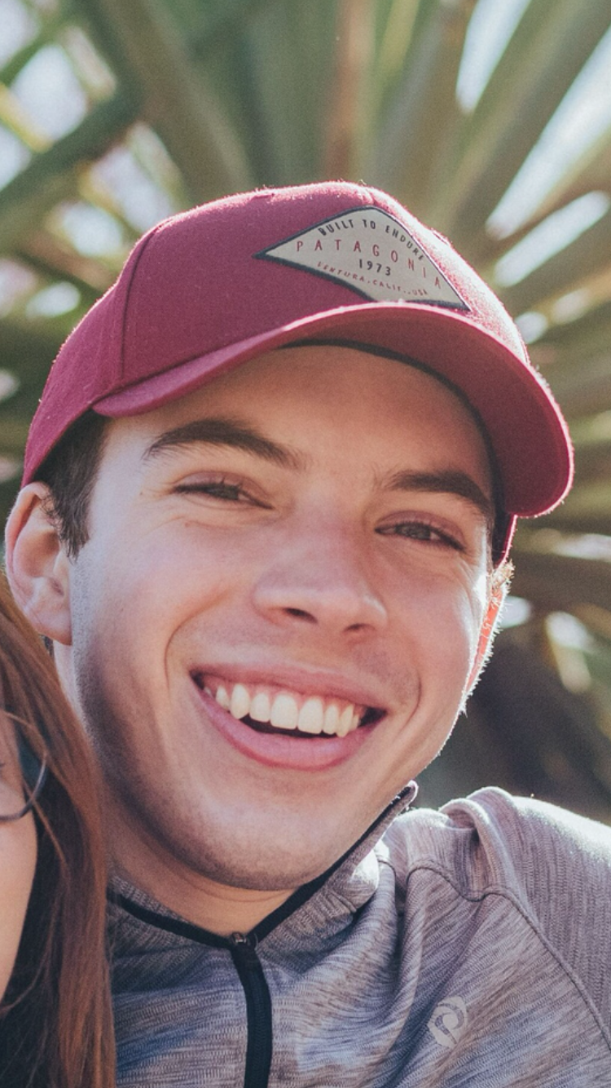
Student profile
Atticus Lemahieu, EnvE/Energy Systems Minor, 2021
“I've been interested in sustainability since I was a kid, so I'm so fortunate to be a part of a team that strives to make an impact towards a more sustainable future not only on the Georgia Tech campus but also in the surrounding area.”
Spring 2018- Joins SLS as student Assistant, helps redesign SLS Teaching Toolkit, assists with SLS Events
Fall 2018- Helps develop RCE Greater Atlanta Youth Network and create community partnership opportunities for students through UN Millennium Fellowship
Spring 2019- Continues work with RCE Greater Atlanta Youth Network, creates weekly newsletters, assists in campus/community outreach
Fall 2019/Spring 2020- Co-Lead SLS Fellows Program, manages marketing material (newsletter, social media)
Career Interests- Alternative/renewable energy sources, agricultural bioengineering, nanomaterials in environmental remediation
Notes:
***

Slide 17
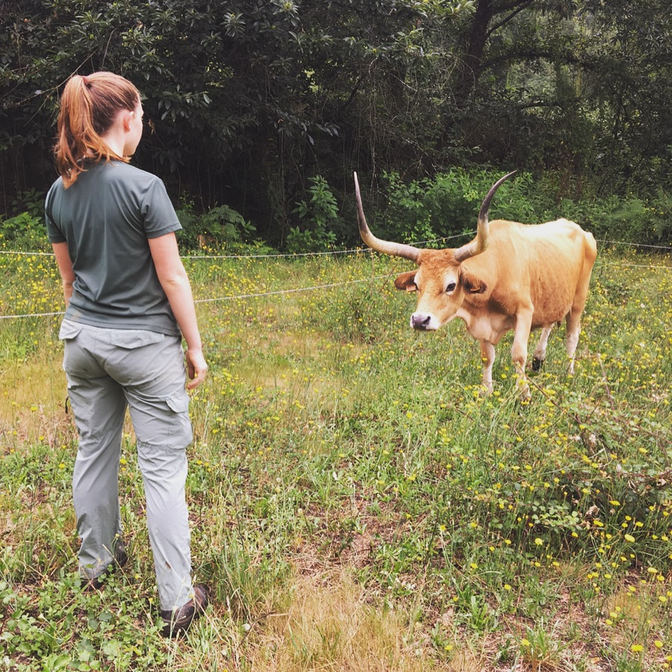
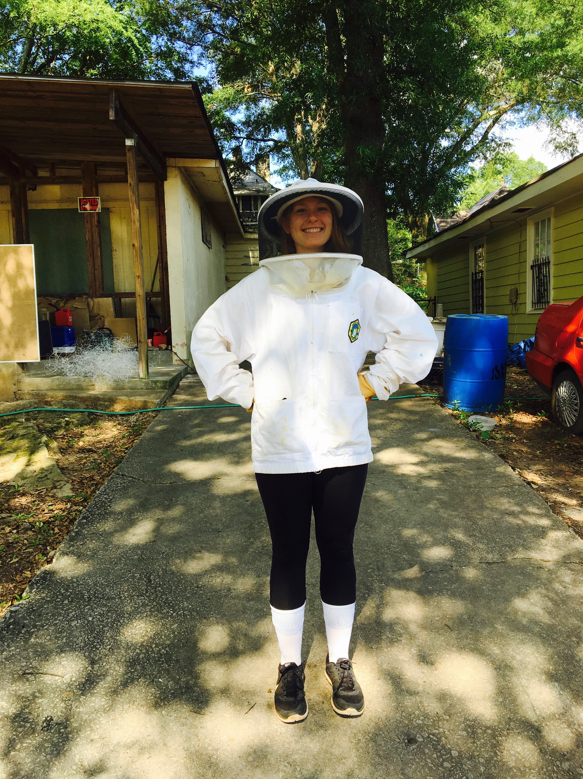
Student profile
Adair Garrett, CEE, 2021
“Serve-Learn-Sustain has been the perfect opportunity for me to expand my passion for sustainability in academic settings and beyond. I believe the SLS is the first step in creating a more environmentally-focused Georgia Tech community.”
Spring 2016 – Takes part in a Serve-Learn-Sustain internship in high school
Fall 2017 – Enters Georgia Tech as a freshmen; contacts SLS to become more involved
Winter 2018 – Signs up for first SLS-affiliated class, Urban Ecology
Spring 2018 – Starts working as SLS Student Assistant
Summer 2018 – Writes first draft of SLS Fellowship program
Summer 2019 -- Participates in SLS Internship Program
Ongoing – Leads SLS Student Fellows Program, incorporates sustainable development in small towns
Notes:
***

Slide 18
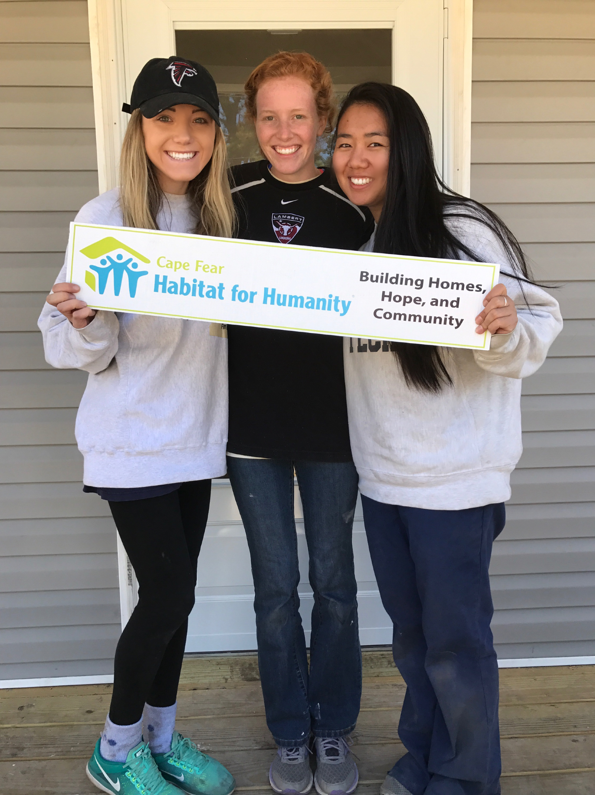
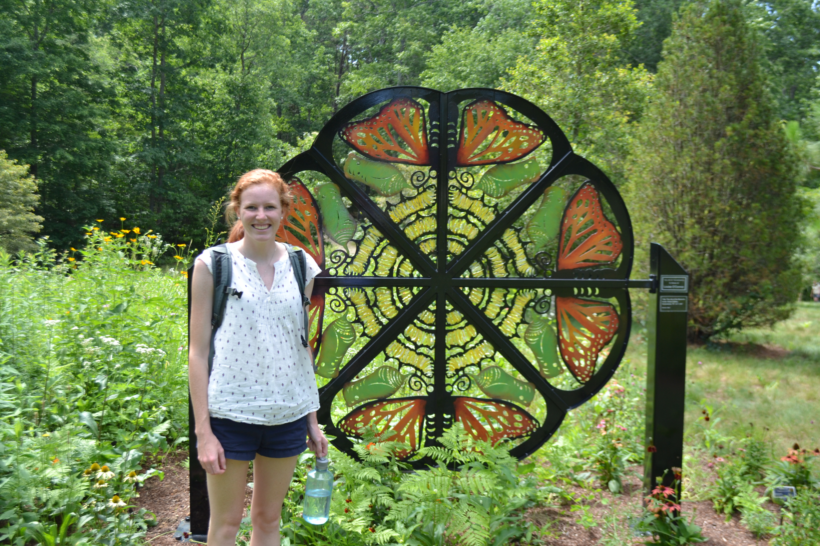
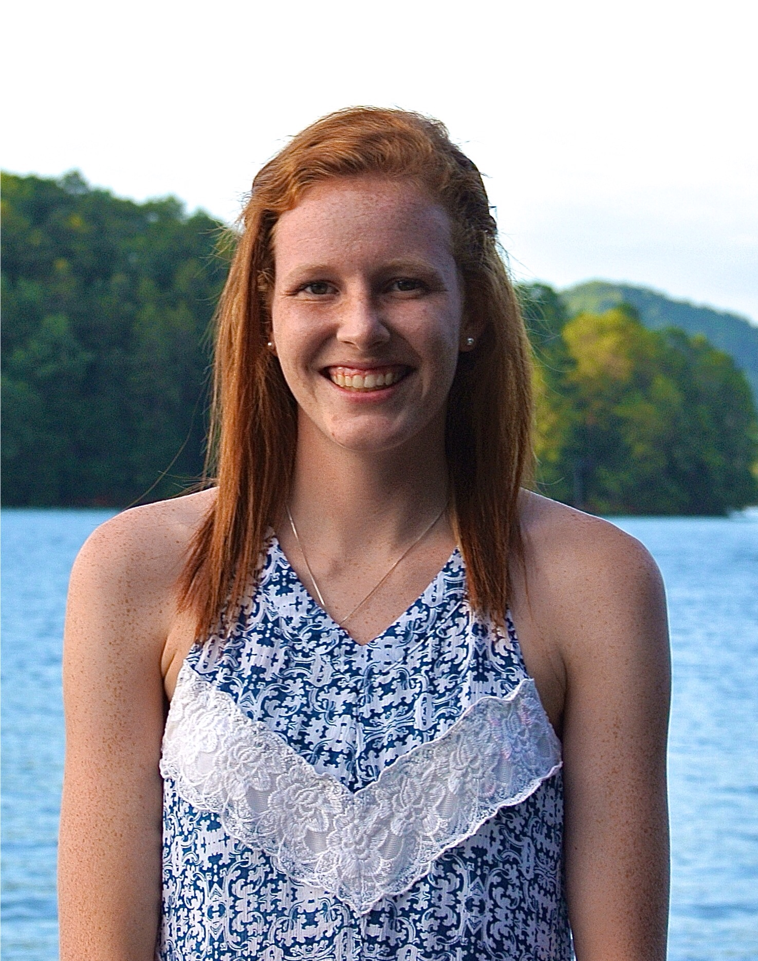
Student profile
Kat Matthews, Marketing/ ID Minor, 2019
“As a transfer student to Tech, I never thought that this is where my path would take me. This past year, I have been learned so many new things about sustainability and its impact on others. I look forward to continuing this journey, and using my design skills to share this knowledge with others.”
Spring 2017: Participates on Alternative Service Break trip working with Habitat for Humanity in Wilmington, NC
Summer 2017: Works at OmniMax International as a marketing intern and completes extensive research on living walls and the trend of sustainability
Fall 2017: Takes Sustainable Marketing with Dionne Nickerson where we visited Global Growers and the Nature Conservancy
Spring 2018: Began working as visual designer for SLS
2018 and Beyond: Continue to become more involved with SLS through events and activities
Career Interest: Integrate my design skills, knowledge of marketing, and interest in sustainability to educate others
Notes:
***

Slide 19
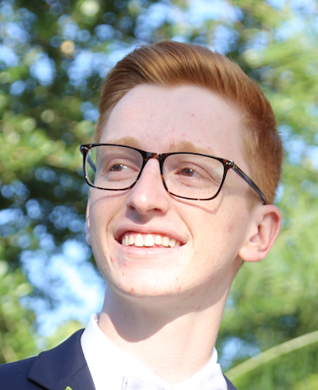
Student profile
Brett Roth, ME, 2022
“Even though I have only been involved with SLS for a short period of time, the various programs and activities offered have altered my perspective on what sustainability is. SLS has allowed me to develop and use a new, more broadly focused lens to solve problems with. It is incredible that opportunities like these are offered to Tech students."
Fall 2018: Attended SLS oriented GT 1000 class taught by Ms. Chatfield; introduced to the concept of sustainable design
Spring 2019: Began working for SLS, eager to work with this team to continue improving Tech
Notes:
***

Slide 20
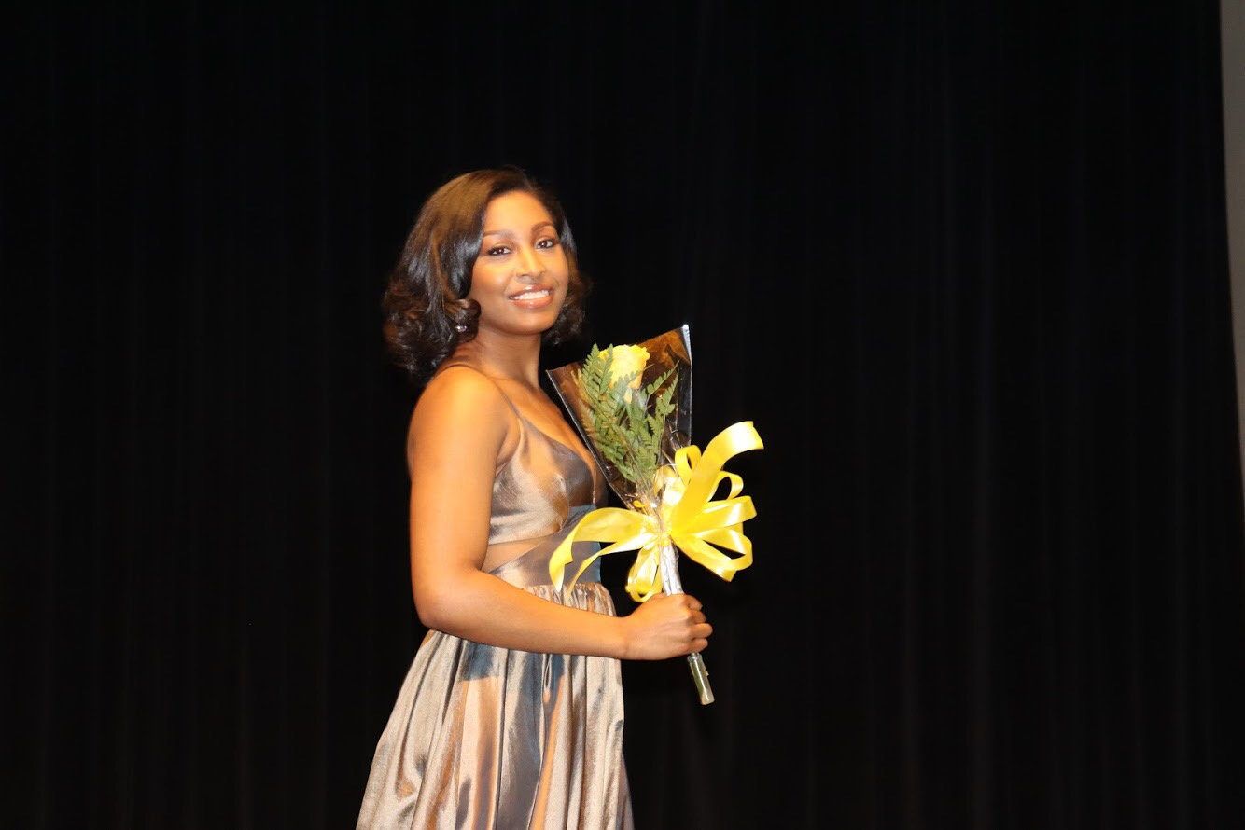
Student profile
“Although I am a biomedical engineering student, I’ve grown up learning to love and contribute to the spaces I am a part of physically, like the earth, and in an abstract sense like communities. SLS gives me the opportunities to accomplish this and have insight into how one can facilitate a connection between the biomedical field and sustainability.“
Josslyn Lally, BME, 2021
Spring 2019- Begins working for SLS with the goal of engaging more students and faculty in SLS.
Student Lead 2019 MLK Day of Service WAWA Project.
Notes:
***

Slide 21
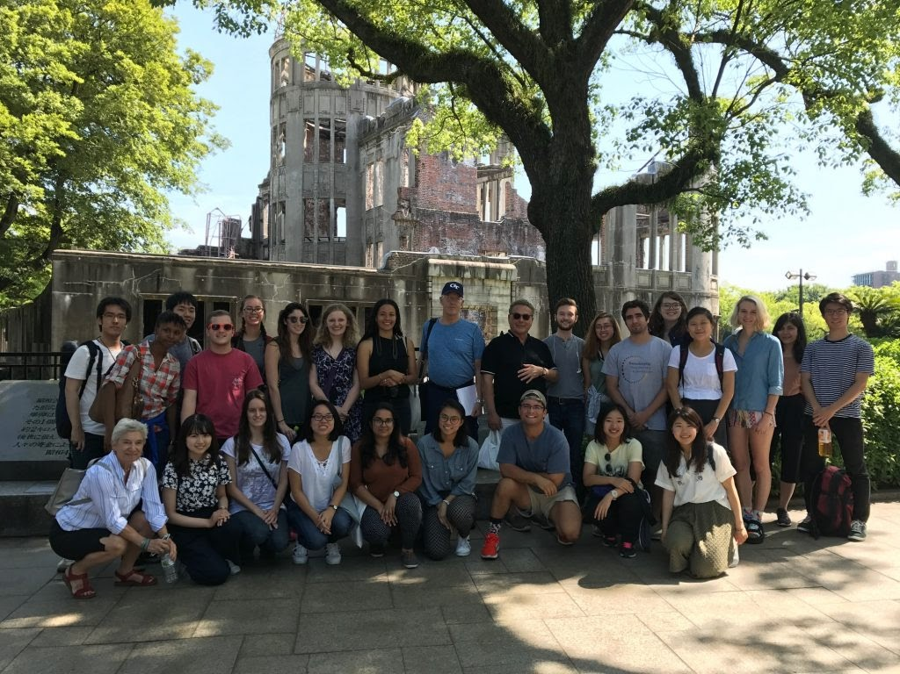
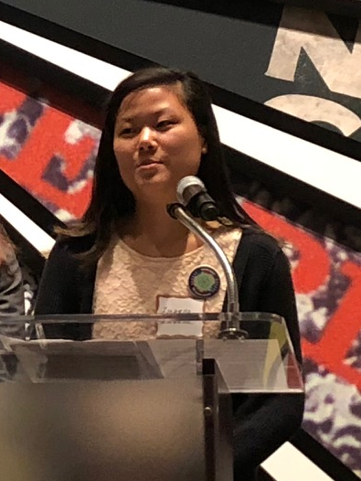
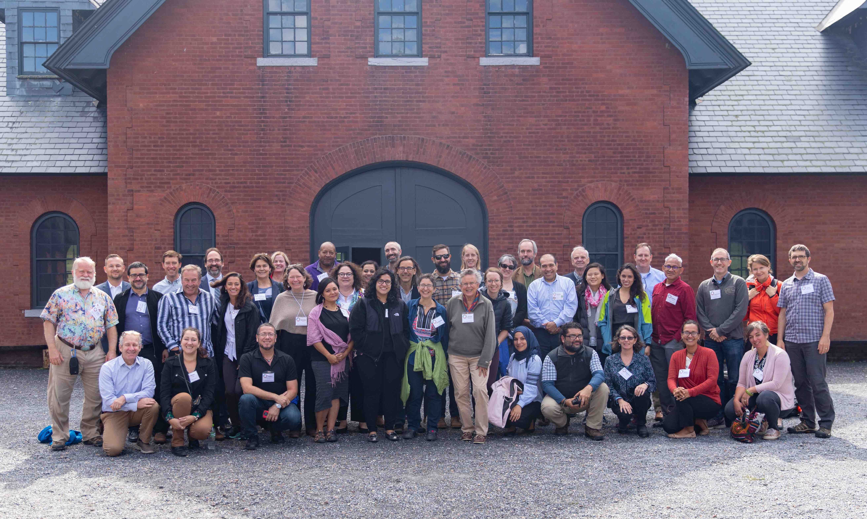
Student profile
Isabella Stubbs, EnvE 2020
Fall 2016: Learns about SLS at FASET, attends the Global Growers service project w/ SLS & OIE
Summer 2017: Participates in SLS-affiliated Japan Summer Program in Sustainable Development at Tokyo Institute of Technology​
Fall 2017: Attends River Rendezvous service project and Planning as if People Eat seminar w/ SLS
Summer 2018: Participates in inaugural SLS Internship Program: works for SLS and the Director of Sustainability (City of Atlanta Office of Resilience) on UN RCE Greater Atlanta research and development
Fall 2018: and Beyond: Continued employment at SLS as an intern, primarily working to develop RCE Greater Atlanta’s Youth Network (collegiate & young alumni network)
Career Goals: Interested in pursuing a Masters degree in planning and sustainability. Wants to work in the sustainability field with a focus on “engineering for social good” and community development.
Japan Study Abroad
RCE Americas Conference - VT
Notes:
***

